Slide 1
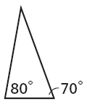
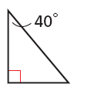
Warm Up
Name each triangle by its angle measures.
1. 2.
3. If a = 6, b = 7, and c = 12, find a² + b² and find c². Which value is greater?
4. Simplify $\sqrt{81}$ 5. Simplify $\sqrt{121}$
acute
right
85; 144; c²
9
11

Slide 2
Vocabulary Review
Sum:
(Square) a number:
Right Triangle:
Hypotenuse:
Value you get when adding
Multiply by itself
A triangle with a right angle
The side in a triangle across from the right angle
Objective: Use the Pythagorean Theorem and its converse to solve real world problems.

Slide 3
Math in Sports!

Slide 4
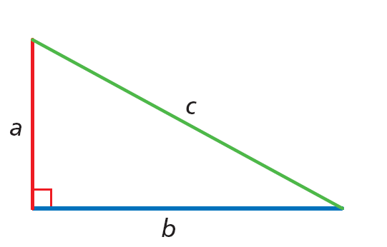
States that in a right triangle, the sum of the squares of the lengths of the two legs equals the square of the length of the hypotenuse.
a² + b² = c²
leg² + leg² = hypotenuse²

Slide 5
Visual Proof
a c
b

Slide 6
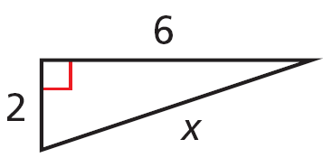
Example 1: Using the Pythagorean Theorem
Find the value of x.
4
3
a² + b² = c²
Pythagorean Theorem
3² + 4² = x²
Substitute 3 for a, 4 for b, and x for c.
25 = x²
Simplify.
5 = x
Find the positive square root.

Slide 7
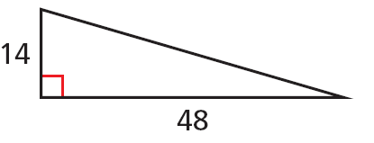
Example 3: Using the Pythagorean Theorem
Find the missing side length.
a² + b² = c²
Pythagorean Theorem
14² + 48² = c²
Substitute 14 for a and 48 for b.
2500 = c²
Multiply and add.
50 = c
Find the positive square root.

Slide 8
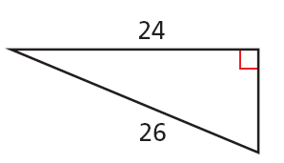
Check It Out! Example 4
Find the missing side length.
a² + b² = c²
Pythagorean Theorem
24² + b² = 26²
Substitute 24 for a and 26 for c.
576 + b² = 676
Multiply
b² = 100
Subtract.
b = 10
Find the positive square root.

Slide 9
Example 1: Using the Pythagorean Theorem
Find the value of x.
6
4
a² + b² = c²
Pythagorean Theorem
6² + 4² = x²
Substitute 2 for a, 6 for b, and x for c.
52 = x²
Simplify.
7.2 $≈$ x
Find the positive square root.

Slide 10
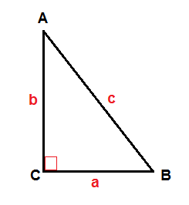
Student Practice
Complete the practice problems on the worksheet!

Slide 11
A set of three counting numbers a, b, and c such that a² + b² = c² is called a Pythagorean triple.

Slide 12
Real World Example
1. An entertainment center is 52 in. wide and 40 in. high. Will a TV with a 60 in. diagonal fit in it? Explain.

Slide 14
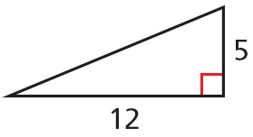
Extra Practice
Find the missing side length. Tell if the side lengths form a Pythagorean triple. Explain.
13; yes; the side lengths are nonzero whole numbers that satisfy Pythagorean’s Theorem.

Slide 15
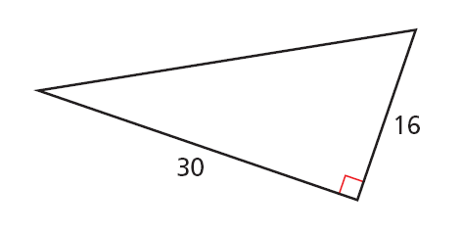
EXTRA PRACTICE
Find the missing side length. Tell if the side lengths form a Pythagorean triple. Explain.
a² + b² = c²
Pythagorean Theorem
30² + 16² = c²
Substitute 30 for a and 16 for b.
c² = 1156
Multiply.
c = 34
Find the positive square root.
Yes. The three side lengths are counting numbers that satisfy Pythagorean's Theorem.

Slide 16
Related Video Reviews
Math Mistakes in Movies
Goofy video explaining Pythagorean Theorem
Brainpop Pythagorean Theorem
Username: baltcops Password: brainpop

