Slide 1
Math 132 Day 2 (2/1/18)
CCBC Dundalk

Slide 2
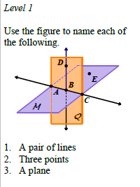
Examples

Slide 3
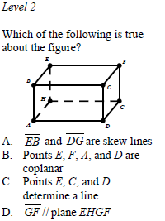

Slide 4
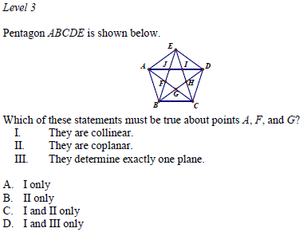
Examples

Slide 5
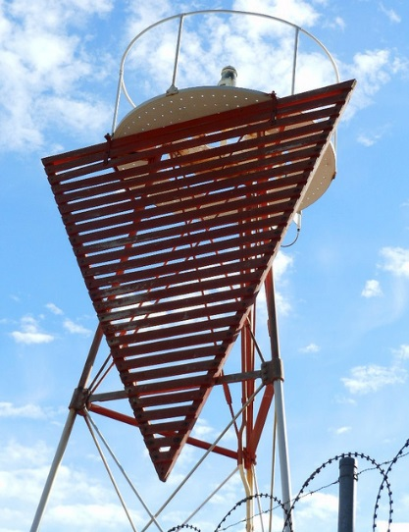
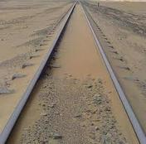
Homework #1: (Due 2/8)
Look through a magazine, newspaper, brochure, etc.. and cut out or label five examples of basic geometry vocabulary words in the real world.
Or…
Take 5 pictures on your phone or camera and label the pictures either in a word document on in a Power Point presentation.

Slide 6
Axioms About Points, Lines, and Planes
There is exactly one line that contains any two distinct points.
If two points lie in a plane, then the line containing the points lies in the plane.
If two distinct planes intersect, then their intersection is a line.
There is exactly one plane that contains any three distinct noncollinear points.

Slide 7
Theorems About Points, Lines, and Planes
A line and a point not on the line determine a plane.
Two parallel lines determine a plane.
Two intersecting lines determine a plane.

Slide 8
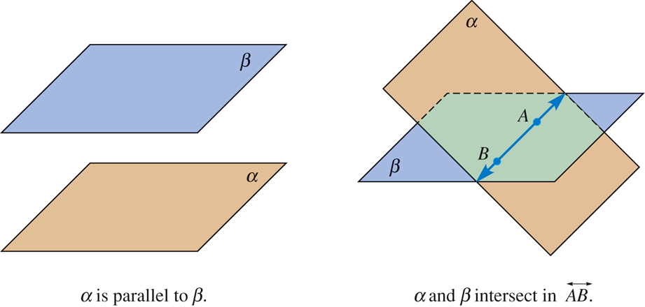
Other Planar Notions

Slide 9
Half plane
Line AB separates plane  into two half-planes.

Slide 10
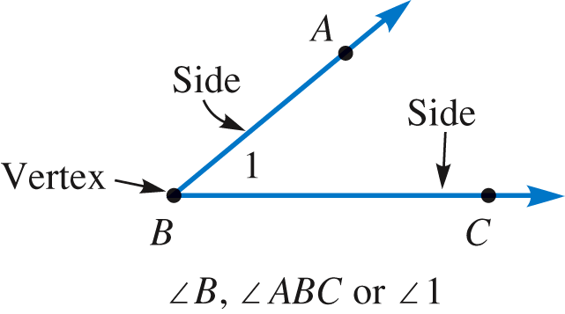
Angles
Angle – formed by two rays with the same endpoint.
Sides of an angle – the two rays that form an angle.
Vertex – the common endpoint of the two rays that form an angle.

Slide 11
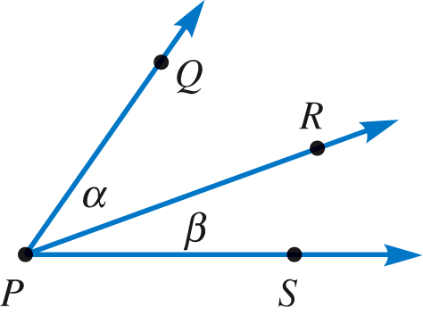
Angles
Adjacent angles – two angles with a common vertex and a common side, but without overlapping interiors.
QPR is adjacent to RPS.

Slide 12
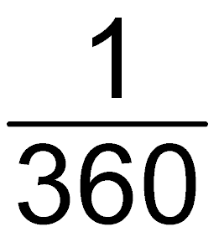
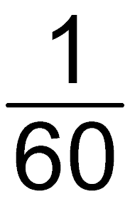
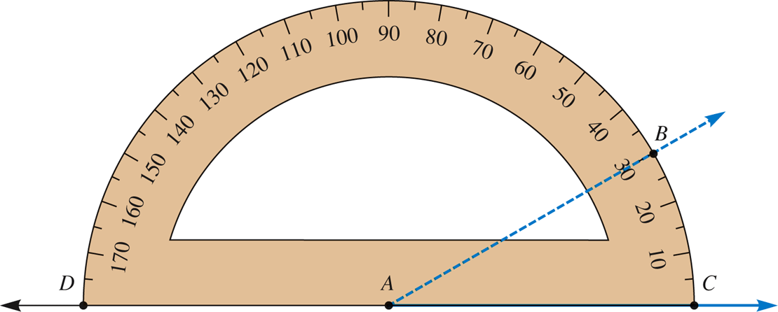
Angle Measurement
Degree : of a rotation about a point
Minute : of a degree
Second : of a minute
Protractor

Slide 13
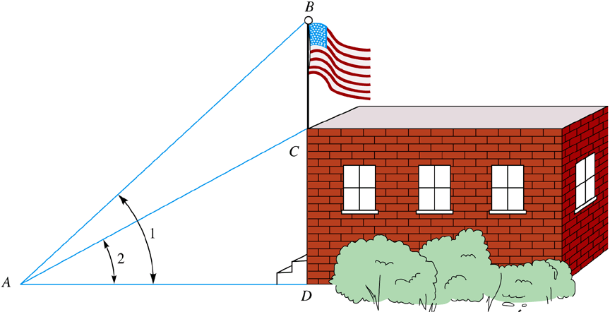
Example 11-1
a. Find the measure of BAC if m1 = 47°45′ and m2 = 29°58′ .
mBAC = 17°47′
b. Express 47°45′36″ as a number of degrees.
47°45′36″ = 47°+ 0.75° + 0.01° = 47.76°

Slide 14
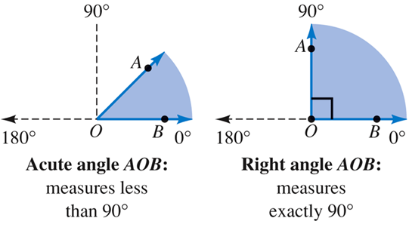
Types of Angles

Slide 15
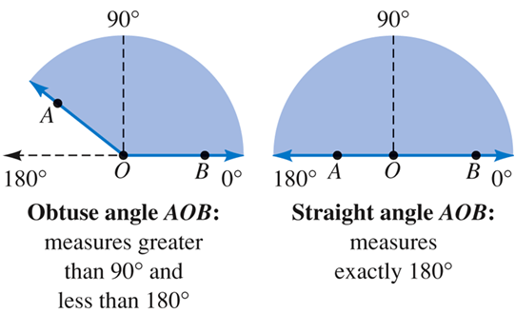
Types of Angles

Slide 16
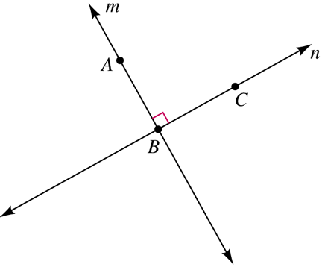
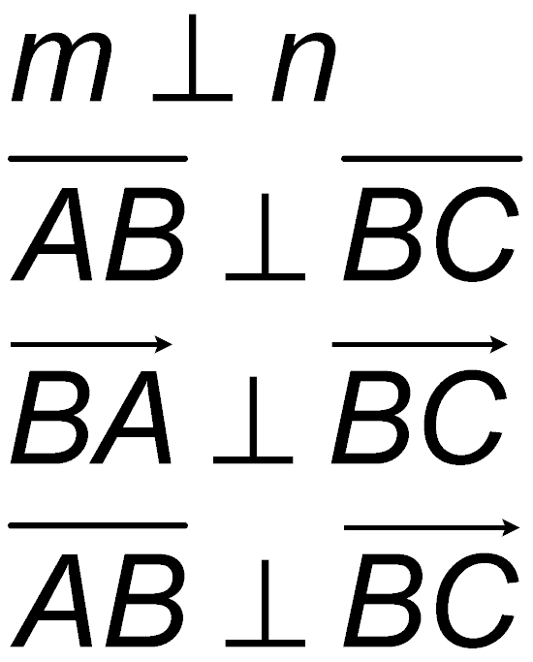
Perpendicular Lines

Slide 17
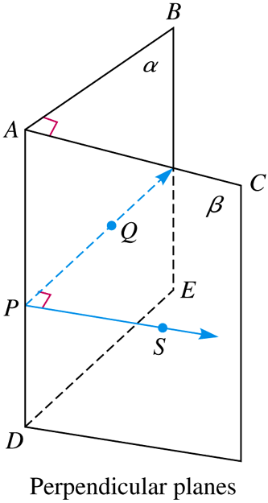
Perpendicular Planes
If P is any point on AD, Q in plane α, and S in plane β so that
PQ  AD and PS  AD, then QPS is also a right angle.
Since QPS measures 90°, the planes are perpendicular.

