Slide 1
K4 Spheres

Slide 2
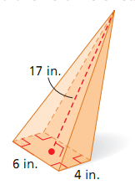
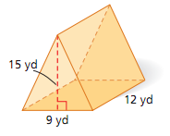
Drill: Tues, June 7th
Find the volume of each figure:
OBJ: SWBAT determine the surface area and volume of spheres.

