Slide 1
10-7
Volume of Pyramids and Cones
Warm Up
Lesson Presentation
Lesson Quiz
Holt McDougal Geometry
Holt Geometry

Slide 2
Warm Up
Find the volume of each figure. Round to the nearest tenth, if necessary.
1. a square prism with base area 189 ft² and height 21 ft
2. a regular hexagonal prism with base edge length 24 m and height 10 m
3. a cylinder with diameter 16 in. and height 22 in.
3969 ft³
14,964.9 m³
4423.4 in³

Slide 3
Objectives
Learn and apply the formula for the volume of a pyramid.
Learn and apply the formula for the volume of a cone.

Slide 4
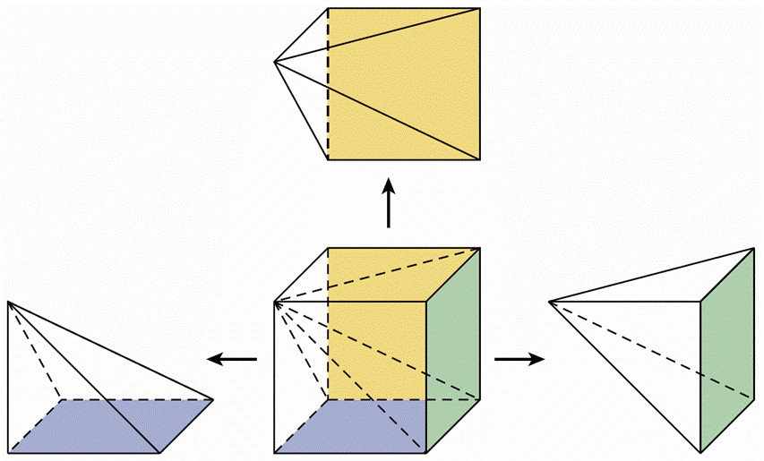
The volume of a pyramid is related to the volume of a prism with the same base and height. The relationship can be verified by dividing a cube into three congruent square pyramids, as shown.

Slide 5
The square pyramids are congruent, so they have the same volume. The volume of each pyramid is one third the volume of the cube.

Slide 6
Example 1A: Finding Volumes of Pyramids
Find the volume a rectangular pyramid with length 11 m, width 18 m, and height 23 m.

Slide 7
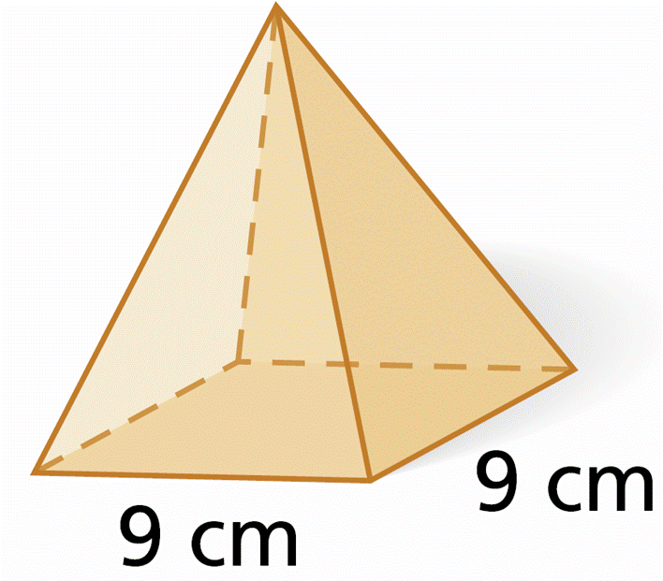
Example 1B: Finding Volumes of Pyramids
Find the volume of the square pyramid with base edge length 9 cm and height 14 cm.
The base is a square with a side length of 9 cm, and the height is 14 cm.

Slide 8
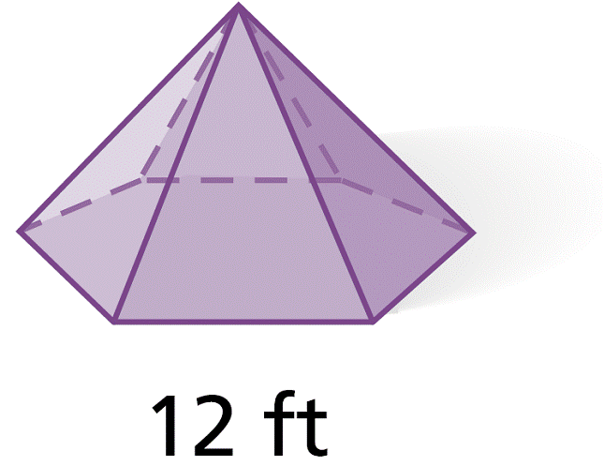
Example 1C: Finding Volumes of Pyramids
Find the volume of the regular hexagonal pyramid with height equal to the apothem of the base
Step 1 Find the area of the base.
Area of a regular polygon
Simplify.

Slide 9
Example 1C Continued
Find the volume of the regular hexagonal pyramid with height equal to the apothem of the base
Step 2 Use the base area and the height to find the volume. The height is equal to the apothem, .
Volume of a pyramid.
= 1296 ft³
Simplify.

Slide 10
Check It Out! Example 1
Find the volume of a regular hexagonal pyramid with a base edge length of 2 cm and a height equal to the area of the base.
Step 1 Find the area of the base.
Area of a regular polygon
Simplify.

Slide 11
Check It Out! Example 1 Continued
Find the volume of a regular hexagonal pyramid with a base edge length of 2 cm and a height equal to the area of the base.
Step 2 Use the base area and the height to find the volume.
Volume of a pyramid
= 36 cm³
Simplify.

Slide 12
Example 2: Architecture Application
An art gallery is a 6-story square pyramid with base area acre (1 acre = 4840 yd², 1 story ≈ 10 ft). Estimate the volume in cubic yards and cubic feet.
The base is a square with an area of about 2420 yd². The base edge length is . The height is about 6(10) = 60 ft or about 20 yd.
First find the volume in cubic yards.
Volume of a pyramid

Slide 13
Example 2 Continued
Volume of a pyramid
Substitute 2420 for B and 20 for h.
≈ 16,133 yd³ ≈ 16,100 yd³
Then convert your answer to find the volume in cubic feet. The volume of one cubic yard is (3 ft)(3 ft)(3 ft) = 27 ft³. Use the conversion factor to find the volume in cubic feet.

Slide 14
Check It Out! Example 2
What if…? What would be the volume of the Rainforest Pyramid if the height were doubled?
Volume of a pyramid.
Substitute 70 for B and 66 for h.
= 107,800 yd³
or 107,800(27) = 2,910,600 ft³

Slide 16
Example 3A: Finding Volumes of Cones
Find the volume of a cone with radius 7 cm and height 15 cm. Give your answers both in terms of π and rounded to the nearest tenth.
Volume of a pyramid
Substitute 7 for r and 15 for h.
= 245π cm³ ≈ 769.7 cm³
Simplify.

Slide 17
Example 3B: Finding Volumes of Cones
Find the volume of a cone with base circumference 25π in. and a height 2 in. more than twice the radius.
Step 1 Use the circumference to find the radius.
2πr = 25π
Substitute 25π for the circumference.
r = 12.5
Solve for r.
Step 2 Use the radius to find the height.
h = 2(12.5) + 2 = 27 in.
The height is 2 in. more than twice the radius.

Slide 18
Example 3B Continued
Find the volume of a cone with base circumference 25π in. and a height 2 in. more than twice the radius.
Step 3 Use the radius and height to find the volume.
Volume of a pyramid.
Substitute 12.5 for r and 27 for h.
= 1406.25π in³ ≈ 4417.9 in³
Simplify.

Slide 19
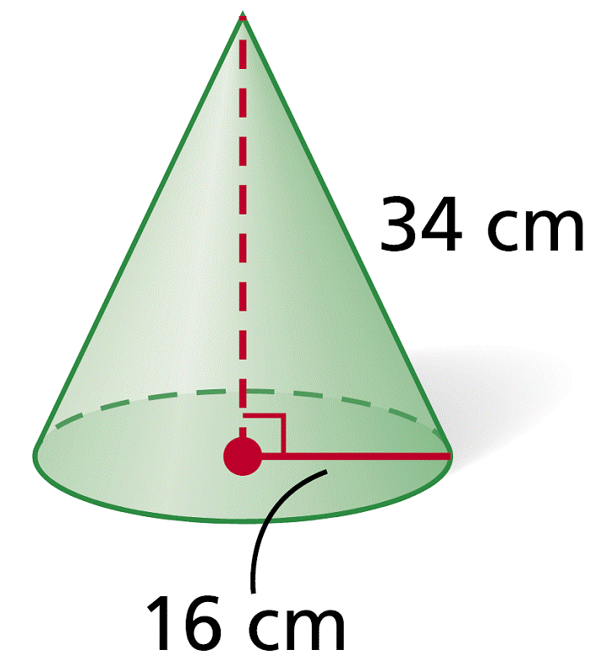
Example 3C: Finding Volumes of Cones
Find the volume of a cone.
Step 1 Use the Pythagorean Theorem to find the height.
16² + h² = 34²
Pythagorean Theorem
h² = 900
Subtract 16² from both sides.
h = 30
Take the square root of both sides.

Slide 20
Example 3C Continued
Find the volume of a cone.
Step 2 Use the radius and height to find the volume.
Volume of a cone
Substitute 16 for r and 30 for h.
≈ 2560π cm³ ≈ 8042.5 cm³
Simplify.

Slide 21
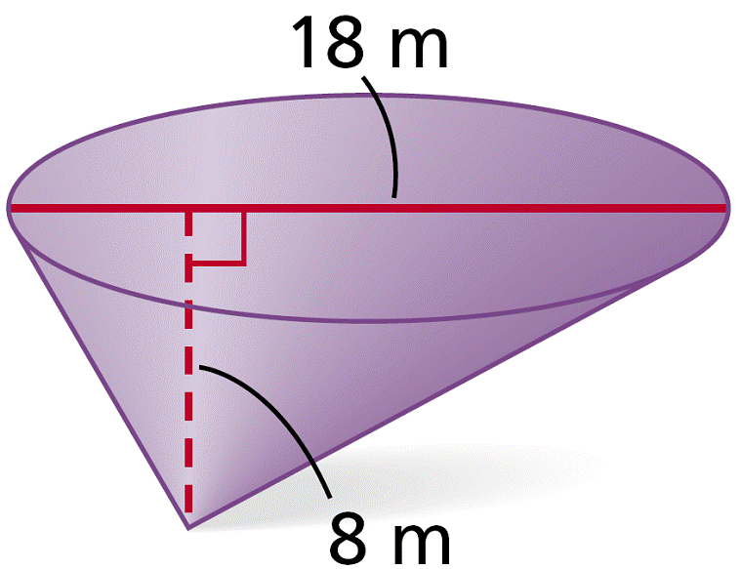
Check It Out! Example 3
Find the volume of the cone.
Volume of a cone
Substitute 9 for r and 8 for h.
≈ 216π m³ ≈ 678.6 m³
Simplify.

Slide 22
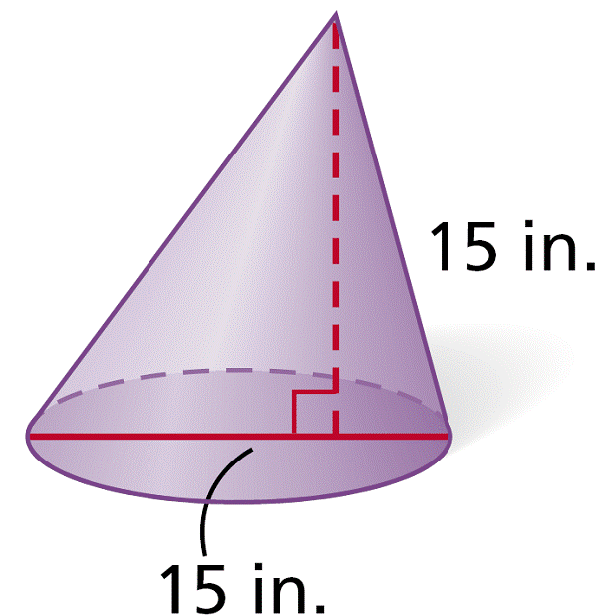
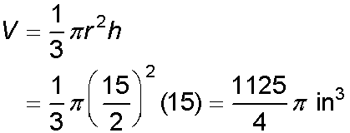
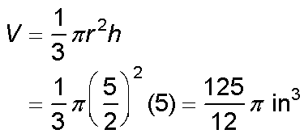
Example 4: Exploring Effects of Changing Dimensions
The diameter and height of the cone are divided by 3. Describe the effect on the volume.
original dimensions:
radius and height divided by 3:
Notice that . If the radius and height are divided by 3, the volume is divided by 3³, or 27.

Slide 23
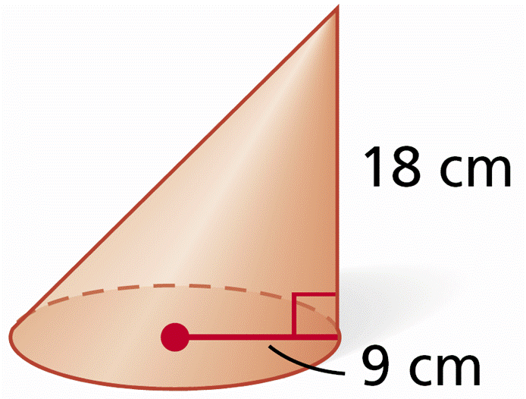
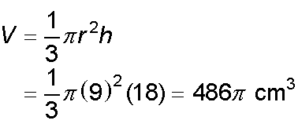
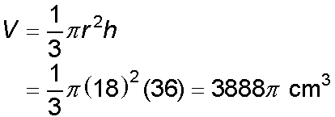
Check It Out! Example 4
The radius and height of the cone are doubled. Describe the effect on the volume.
original dimensions:
radius and height doubled:
The volume is multiplied by 8.

Slide 24
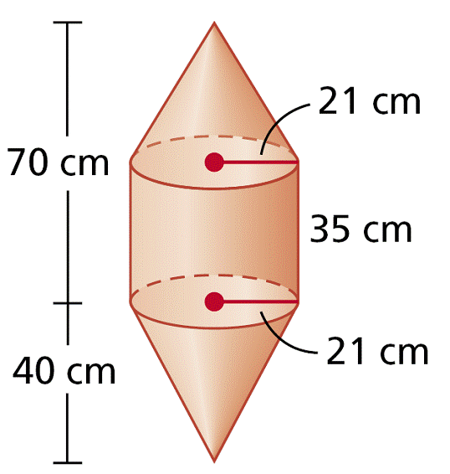
Example 5: Finding Volumes of Composite Three-Dimensional Figures
Find the volume of the composite figure. Round to the nearest tenth.
The volume of the upper cone is

Slide 25
Example 5: Finding Volumes of Composite Three-Dimensional Figures
Find the volume of the composite figure. Round to the nearest tenth.
The volume of the cylinder is
V_{cylinder} = πr²h = π(21)²(35)=15,435π cm³.
The volume of the lower cone is
The volume of the figure is the sum of the volumes.
V = 5145π + 15,435π + 5,880π = 26,460π ≈ 83,126.5 cm³

Slide 26
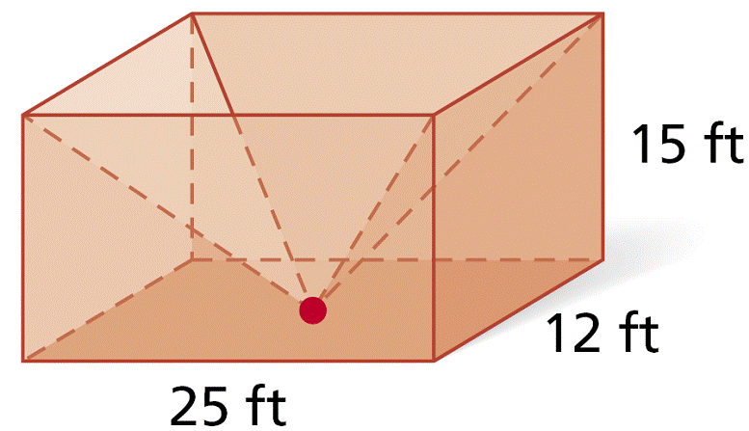
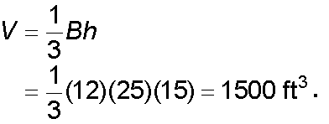
Check It Out! Example 5
Find the volume of the
composite figure.
The volume of the rectangular prism is
V = ℓwh = 25(12)(15) = 4500 ft³.
The volume of the pyramid is
The volume of the composite is the rectangular prism subtract the pyramid.
4500 — 1500 = 3000 ft³

Slide 27
Lesson Quiz: Part I
Find the volume of each figure. Round to the nearest tenth, if necessary.
1. a rectangular pyramid with length 25 cm, width 17 cm, and height 21 cm
2. a regular triangular pyramid with base edge length 12 in. and height 10 in.
3. a cone with diameter 22 cm and height 30 cm
4. a cone with base circumference 8π m and a height 5 m more than the radius
2975 cm³
207.8 in³
V ≈ 3801.3 cm³
V ≈ 117.3 m²

Slide 28
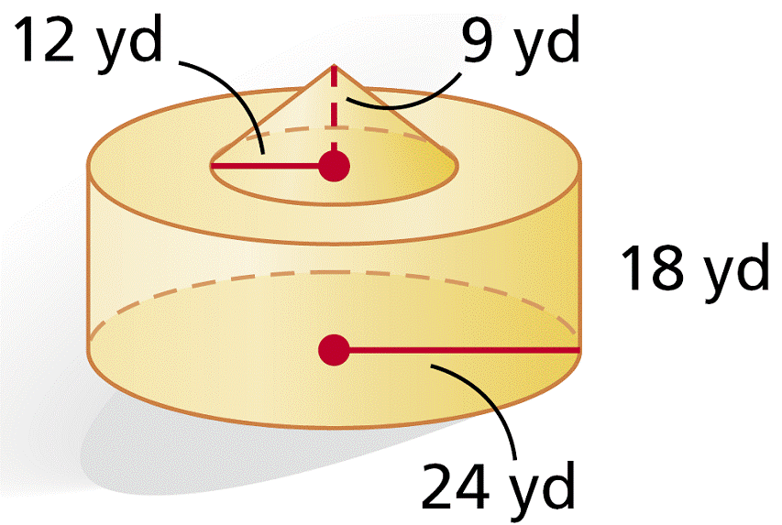
Lesson Quiz: Part II
5. A cone has radius 2 in. and height 7 in. If the radius and height are multiplied by , describe the effect on the volume.
6. Find the volume of the composite figure. Give your answer in terms of π.
The volume is multiplied by .
10,800π yd³

