Slide 1
10-2
Representations of Three-Dimensional Figures
Warm Up
Lesson Presentation
Lesson Quiz
Holt McDougal Geometry
Holt Geometry

Slide 2
Warm Up
Write a description of each figure.
1. cube
2. pentagonal prism
3. cylinder
prism with 6 square faces
prism with 2 pentagonal bases and 5 lateral faces that are parallelograms
figure with 2 circular bases connected by a curved surface

Slide 3
Objectives
Draw representations of three-dimensional figures.
Recognize a three dimensional figure from a given representation.

Slide 4
Vocabulary
orthographic drawing
isometric drawing
perspective drawing
vanishing point
horizon

Slide 5
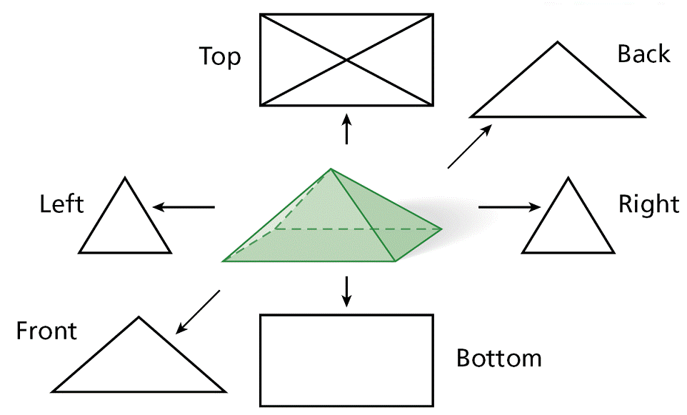
There are many ways to represent a three dimensional object. An orthographic drawing shows six different views of an object: top, bottom, front, back, left side, and right side.

Slide 6
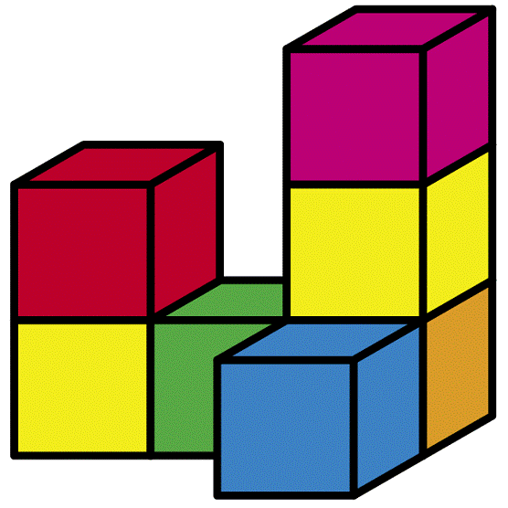
Example 1: Drawing Orthographic Views of an Object
Draw all six orthographic views of the given object. Assume there are no hidden cubes.

Slide 7
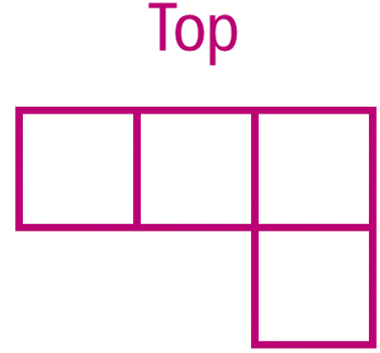
Example 1 Continued
Draw all six orthographic views of the given object. Assume there are no hidden cubes.
Bottom

Slide 8
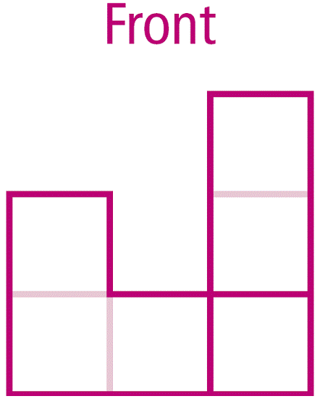
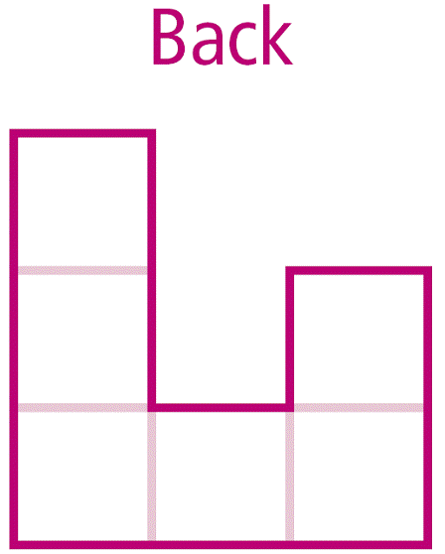
Example 1 Continued
Draw all six orthographic views of the given object. Assume there are no hidden cubes.

Slide 9
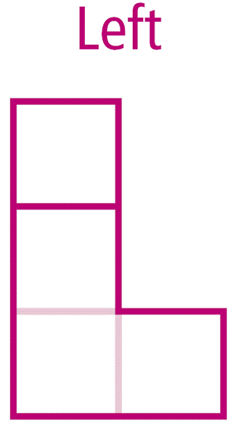
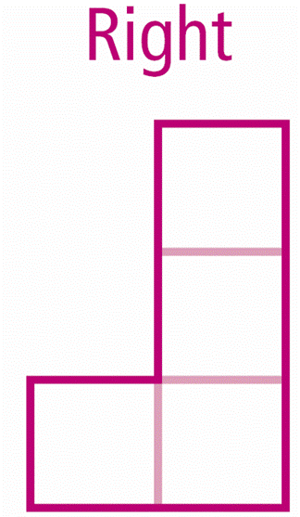
Example 1 Continued
Draw all six orthographic views of the given object. Assume there are no hidden cubes.

Slide 10
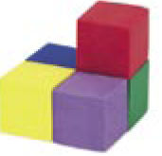
Check It Out! Example 1
Draw all six orthographic views of the given object. Assume there are no hidden cubes.

Slide 11
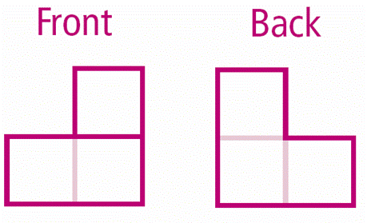
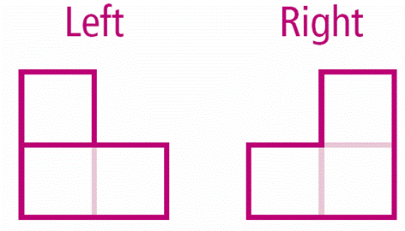
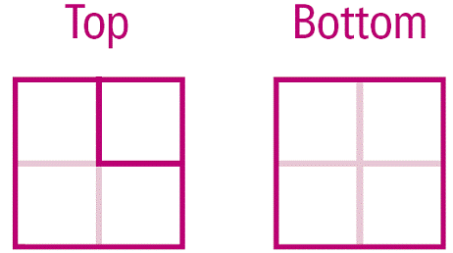
Check It Out! Example 1 Continued

Slide 12
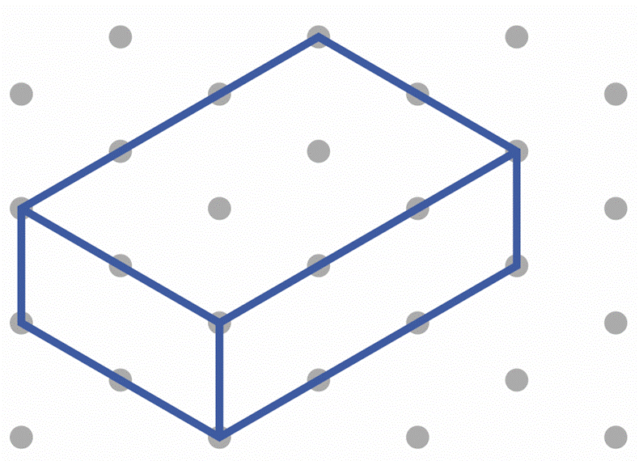
Isometric drawing is a way to show three sides of
a figure from a corner view. You can use isometric dot paper to make an isometric drawing. This paper has diagonal rows of dots that are equally spaced in a
repeating triangular pattern.

Slide 13
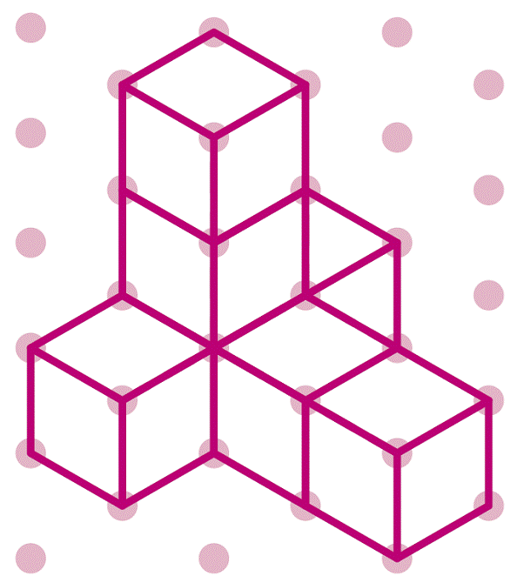
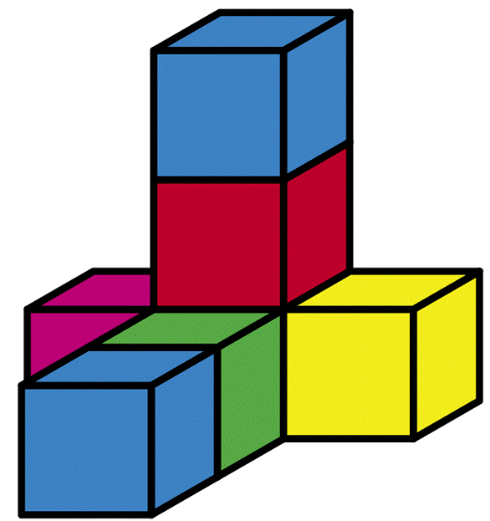
Example 2: Drawing an Isometric View of an Object
Draw an isometric view of the given object. Assume there are no hidden cubes.

Slide 14
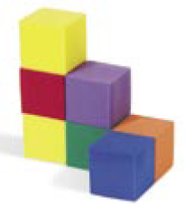
Check It Out! Example 2
Draw an isometric view of the given object. Assume there are no hidden cubes.

Slide 15
In a perspective drawing, nonvertical parallel lines are drawn so that they meet at a point called a vanishing point. Vanishing points are located on a horizontal line called the horizon. A one-point perspective drawing contains one vanishing point. A two-point perspective drawing contains two vanishing points.

Slide 17
Helpful Hint
In a one-point perspective drawing of a cube, you are looking at a face. In a two-point perspective drawing, you are looking at a corner.

Slide 18
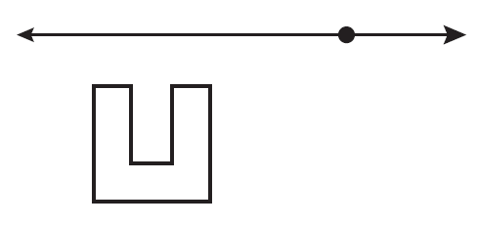
Example 3A: Drawing an Object in Perspective
Draw the block letter in one-point perspective.
Draw a horizontal line to represent the horizon. Mark a vanishing point on the horizon. Then draw a shape below the horizon. This is the front of the .

Slide 19
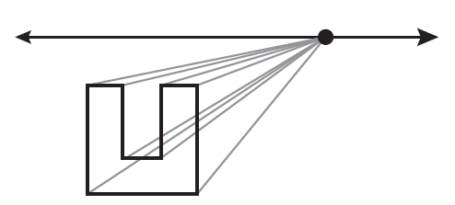
Example 3A Continued
Draw the block letter in one-point perspective.
From each corner of the , lightly draw dashed segments to the vanishing point.

Slide 20
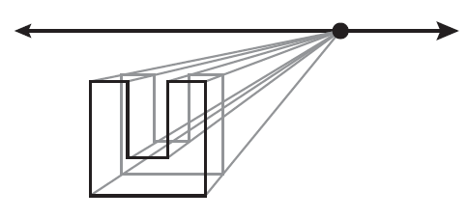
Example 3A Continued
Draw the block letter in one-point perspective.
Lightly draw a smaller with vertices on the dashed segments. This is the back of the .

Slide 21
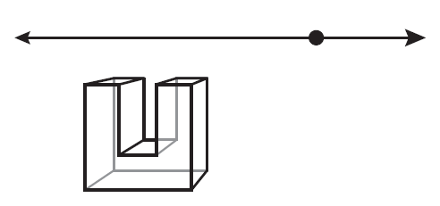
Example 3A Continued
Draw the block letter in one-point perspective.
Draw the edges of the , using dashed segments for hidden edges. Erase any segments that are not part of the .

Slide 22
Example 3B: Drawing an Object in Perspective
Draw the block letter in two-point perspective.
Draw a horizontal line to represent the horizon. Mark two vanishing points on the horizon. Then draw a vertical segment below the horizon and between the vanishing points. This is the front edge of the . Lightly mark a point of the way down the segment, for the lower part of the shape.

Slide 23
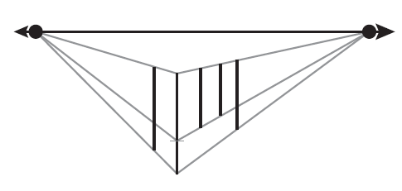
Example 3B Continued
From the marked point and the endpoints of the segment, lightly draw dashed segments to each vanishing point. Draw vertical segments connecting the dashed lines. These are other vertical edges of the .

Slide 24
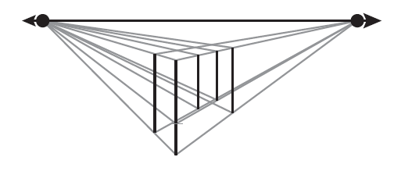
Example 3B Continued
Lightly draw dashed segments from the endpoints of each new vertical segment to the vanishing points.

Slide 25
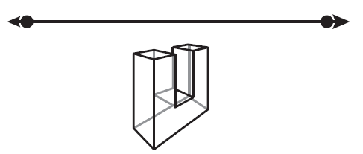
Example 3B Continued
Draw the edges of the , using dashed segments for hidden edges. Erase any segments that are not part of the .

Slide 26
Check It Out! Example 3a
Draw the block letter L in one-point perspective.
Draw a horizontal line to represent the horizon. Mark a vanishing point on the horizon. Then draw a L shape below the horizon. This is the front of the L.

Slide 27
Check It Out! Example 3a Continued
Draw the block letter L in one-point perspective.
From each corner of the L, lightly draw dashed segments to the vanishing point.

Slide 28
Check It Out! Example 3a Continued
Draw the block letter L in one-point perspective.
Lightly draw a smaller L with vertices on the dashed segments. This is the back of the L.

Slide 29
Check It Out! Example 3a Continued
Draw the block letter L in one-point perspective.
Draw the edges of the L, using dashed segments for hidden edges. Erase any segments that are not part of the L.

Slide 30
Check It Out! Example 3b
Draw the block letter L in two-point perspective.
Draw a horizontal line to represent the horizon. Mark two vanishing points on the horizon. Then draw a vertical segment below the horizon and between the vanishing points. This is the front edge of the L. Lightly mark a point of the way down the segment, for the lower part of the L shape.

Slide 31
Check It Out! Example 3b Continued
Draw the block letter L in two-point perspective.
From the marked point and the endpoints of the segment, lightly draw dashed segments to each vanishing point. Draw vertical segments connecting the dashed lines. These are other vertical edges of the L.

Slide 32
Check It Out! Example 3b Continued
Draw the block letter L in two-point perspective.
Lightly draw dashed segments from the endpoints of each new vertical segment to the vanishing points.

Slide 33
Check It Out! Example 3b Continued
Draw the block letter L in two-point perspective.
Draw the edges of the L, using dashed segments for hidden edges to the vanishing points.

Slide 34
Check It Out! Example 3b Continued
Draw the block letter L in two-point perspective.
Erase any segments that are not part of the L.

Slide 35
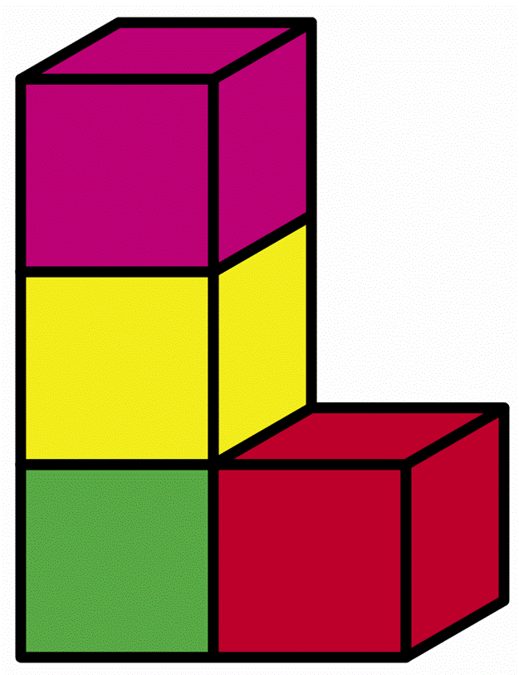
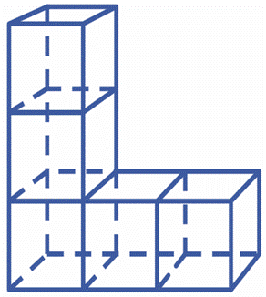
Example 4A: Relating Different Representations of an Object
Determine whether the drawing represents the given object. Assume there are no hidden cubes.
No; the base has one cube too many.

Slide 36
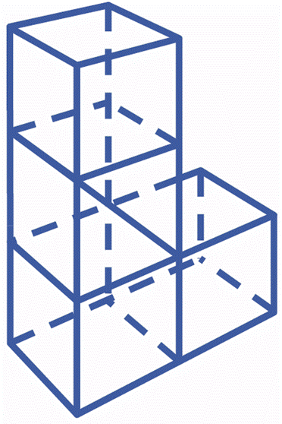
Example 4B: Relating Different Representations of an Object
Determine whether the drawing represents the given object. Assume there are no hidden cubes.
Yes; the drawing is a two-point perspective view of the object.

Slide 37
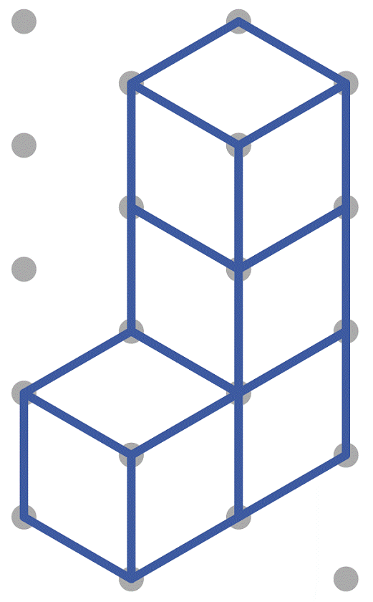
Example 4C: Relating Different Representations of an Object
Determine whether the drawing represents the given object. Assume there are no hidden cubes.
Yes; the drawing is an isometric view of the object.

Slide 38
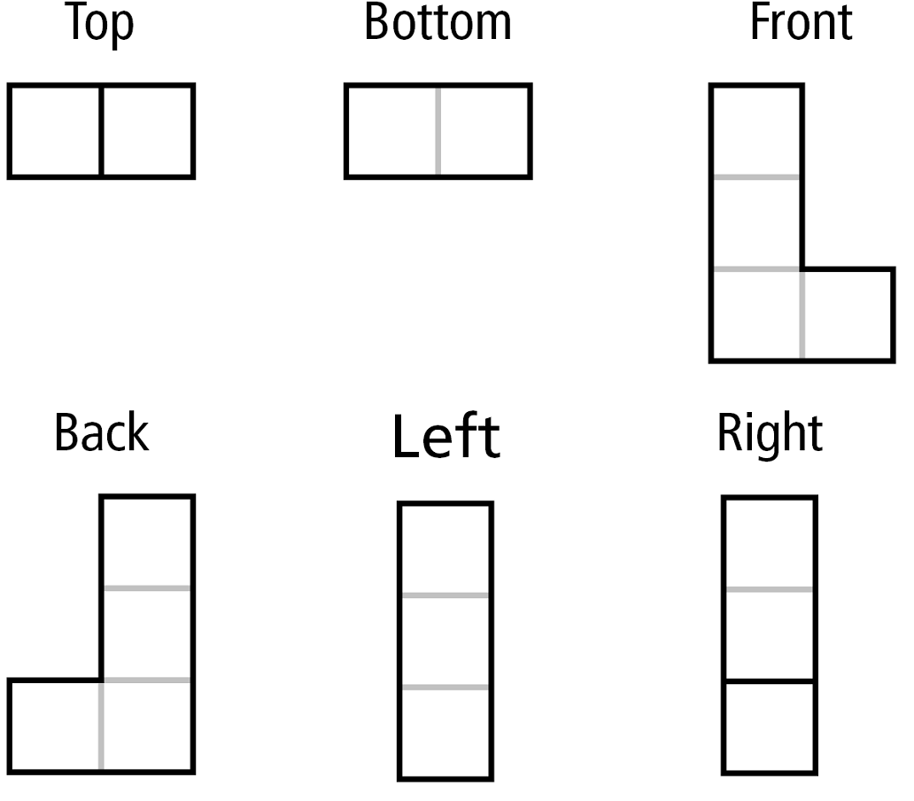
Example 4D: Relating Different Representations of an Object
Determine whether the drawing represents the given object. Assume there are no hidden cubes.
Yes; the drawing shows the six orthographic views of the object.

Slide 39
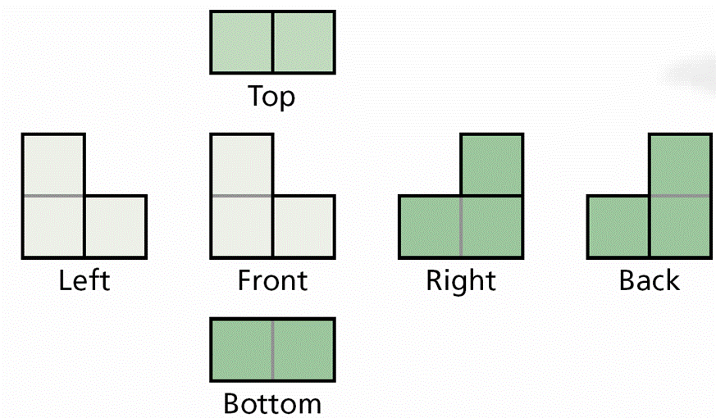
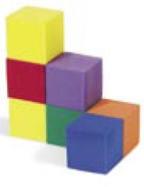
Check It Out! Example 4
Determine whether the drawing represents the
given object. Assume there are no hidden cubes.
no

Slide 40
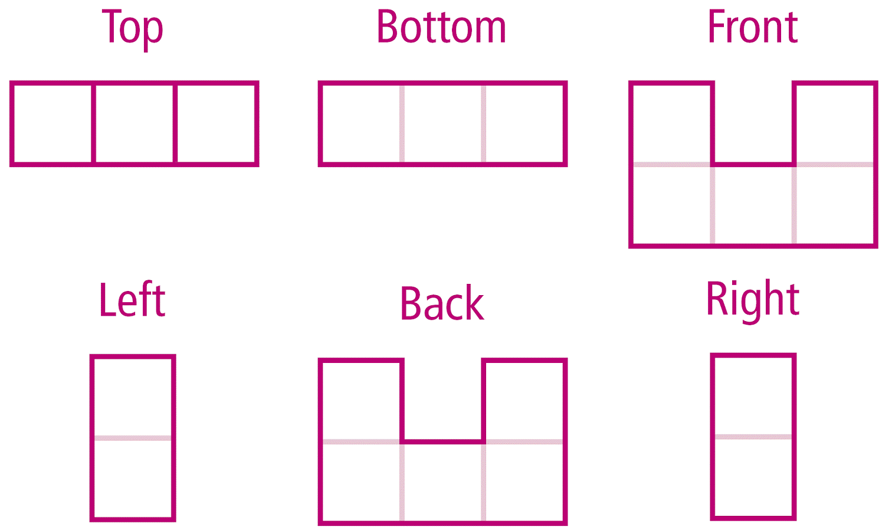
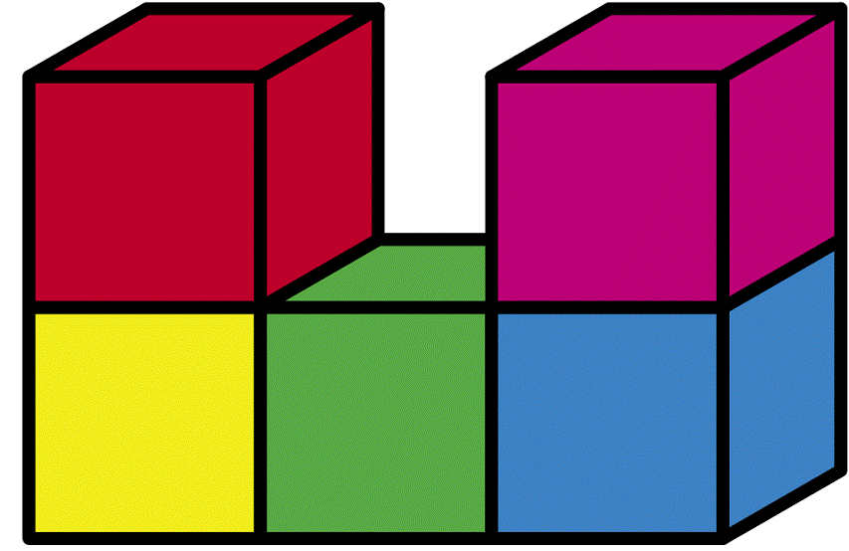
Lesson Quiz: Part I
1. Draw all six orthographic views of the object. Assume there are no hidden cubes.

Slide 41
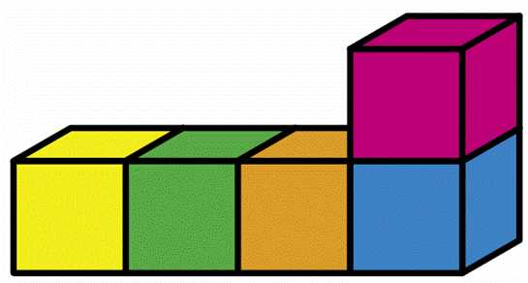
Lesson Quiz: Part II
2. Draw an isometric view of the object.

Slide 42
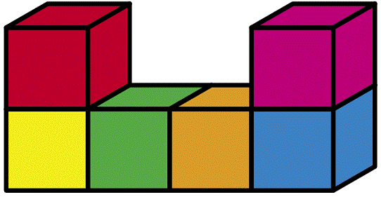
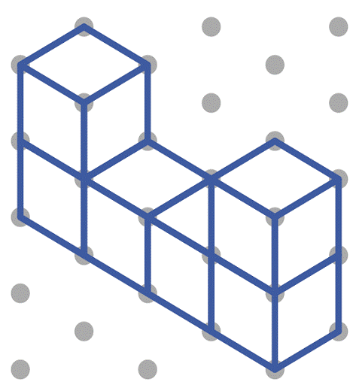
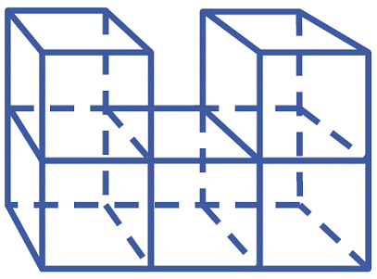
Lesson Quiz: Part III
3. Determine whether each drawing represents the given object. Assume there are no hidden cubes.
yes
yes
no

