Slide 1
Unit 1
Construction Techniques 3: Perpendicular Lines and Angle Bisectors
Constructions and Rigid Transformations
Lesson 5
Notes:
For quick access to the presentation from your own drive, go to File > Add shortcut to Drive.
To customize for your students, go to File > Make a copy to make a copy of the slide deck in your Google Drive that you can edit.
Report a Typo

Slide 2
Let’s use tools to solve some construction challenges.
Unit 1 ● Lesson 5

Slide 3
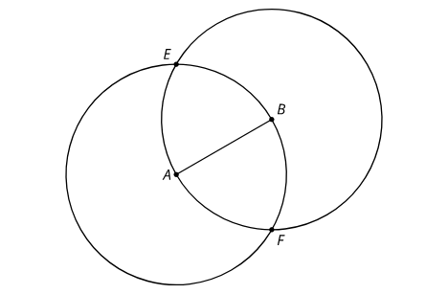
Two Circles
Points A and B are each at the centers of circles of radius AB.
Compare the distance EA to the distance EB. Be prepared to explain your reasoning.
Compare the distance FA to the distance FB. Be prepared to explain your reasoning.
Draw line EF and write a conjecture about its relationship with segment AB.
Unit 1 ● Lesson 5 ● Activity 1

Slide 4
Make It Right
Here is a line l with a point labeled C: Use straightedge and compass tools to construct a line perpendicular to l that goes through C.
Unit 1 ● Lesson 5 ● Activity 2

Slide 5
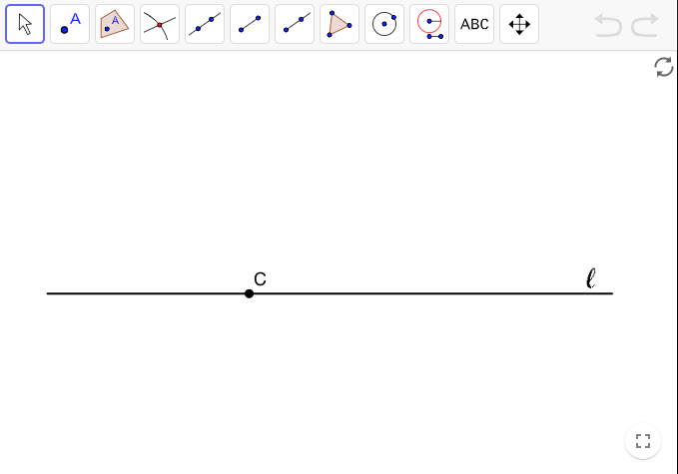
Make It Right
Unit 1 ● Lesson 5 ● Activity 2

Slide 6
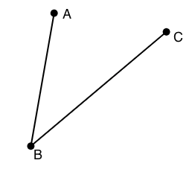
Bisect This
Estimate the location of a point D so that angle ABD is approximately congruent to angle CBD.
Use compass and straightedge tools to create a ray that divides angle CBA into 2 congruent angles. How close is the ray to going through your point D?
Take turns with your partner, drawing and bisecting other angles.
For each angle that you draw, explain to your partner how each straightedge and compass move helps you to bisect it.
For each angle that your partner draws, listen carefully to their explanation. If you disagree, discuss your thinking and work to reach an agreement
Unit 1 ● Lesson 5 ● Activity 3

Slide 7
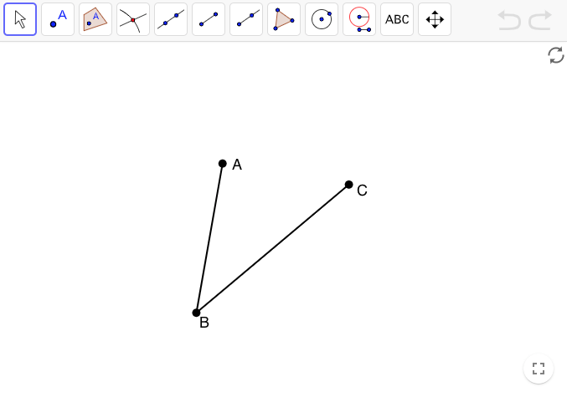
Bisect This
Unit 1 ● Lesson 5 ● Activity 3

Slide 8
Construction Techniques 3: Perpendicular Lines and Angle Bisectors
What was the first step in each of these constructions?
The first circle creates two points that are the same distance away from the center. Now, where do you see the two circles that go through each other’s center in each of the constructions?
Unit 1 ● Lesson 5

Slide 9
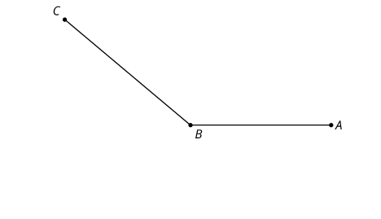
Bisect That
Here is an angle:
Use compass and straightedge moves to construct the angle bisector for angle ABC. In other words, create a ray that divides angle ABC into 2 congruent angles.
Unit 1 ● Lesson 5 ● Activity 4

Slide 10
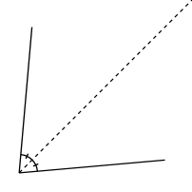
angle bisector
A line through the vertex of an angle that divides it into two equal angles.
Unit 1 ● Lesson 5

Slide 11
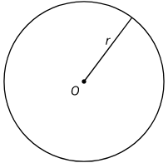
circle
A circle of radius r with center O is the set of all points that are a distance r units from O.
To draw a circle of radius 3 and center O, use a compass to draw all the points at a distance 3 from O.
Unit 1 ● Lesson 5

Slide 12
conjecture
A reasonable guess that you are trying to either prove or disprove.
Unit 1 ● Lesson 5

Slide 13
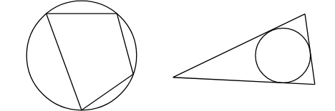
inscribed
We say a polygon is inscribed in a circle if it fits inside the circle and every vertex of the polygon is on the circle. We say a circle is inscribed in a polygon if it fits inside the polygon and every side of the polygon is tangent to the circle.
Unit 1 ● Lesson 5

Slide 14
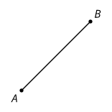
line segment
A set of points on a line with two endpoints.
Unit 1 ● Lesson 5

Slide 15
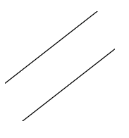
parallel
Two lines that don't intersect are called parallel. We can also call segments parallel if they extend into parallel lines.
Unit 1 ● Lesson 5

Slide 16
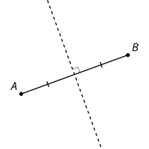
perpendicular bisector
The perpendicular bisector of a segment is a line through the midpoint of the segment that is perpendicular to it.
Unit 1 ● Lesson 5

Slide 17
Unit 1 ● Lesson 5
I can construct a line that is perpendicular to a given line through a point on the line.
I can construct an angle bisector.

Slide 18
Unit 1
Construction Techniques 4: Parallel and Perpendicular Lines
Constructions and Rigid Transformations
Lesson 6
Notes:
For quick access to the presentation from your own drive, go to File > Add shortcut to Drive.
To customize for your students, go to File > Make a copy to make a copy of the slide deck in your Google Drive that you can edit.
Report a Typo

Slide 19
Let’s use tools to draw parallel and perpendicular lines precisely.
Unit 1 ● Lesson 6

Slide 20
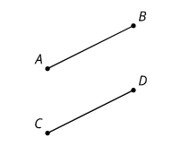
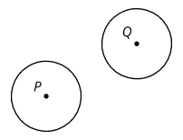
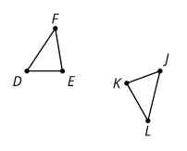
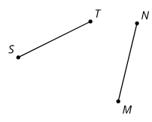
Transformations
Each pair of shapes is congruent. Mentally identify a transformation or sequence of transformations that could take one shape to the other.
Unit 1 ● Lesson 6 ● Activity 1

Slide 21
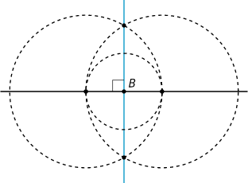
Standing on the Shoulders of Giants
circles of a certain radius
lines and line segments through two points
regular hexagons
equilateral triangles
a perpendicular bisector of a given segment
a perpendicular line through a point on the given line
a perpendicular line through a point not on the given line (added in this lesson)
a parallel line through a point not on the given line (added in this lesson)
Unit 1 ● Lesson 6 ● Activity 2

Slide 22
Standing on the Shoulders of Giants
Here is a line m and a point C not on the line. Use straightedge and compass tools to construct a line perpendicular to line m that goes through point C. Be prepared to share your reasoning.
Unit 1 ● Lesson 6 ● Activity 2

Slide 23
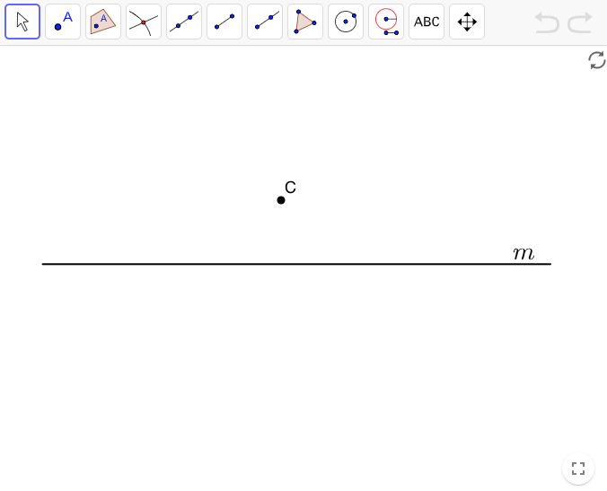
Standing on the Shoulders of Giants
Unit 1 ● Lesson 6 ● Activity 2

Slide 24
Parallel Constructions Challenge
Here is a line m and a point C not on the line. Use straightedge and compass moves to construct a line parallel to line m that goes through point C.
Unit 1 ● Lesson 6 ● Activity 3

Slide 25
Parallel Constructions Challenge
Unit 1 ● Lesson 6 ● Activity 3

Slide 26
Construction Techniques 4: Parallel and Perpendicular Lines
What you can construct:
circles of a certain radius
lines and line segments through two points
regular hexagons
equilateral triangles
a perpendicular bisector of a given segment
a perpendicular line through a point on the given line
a perpendicular line through a point not on the given line (added in this lesson)
a parallel line through a point not on the given line (added in this lesson)
Unit 1 ● Lesson 6

Slide 27
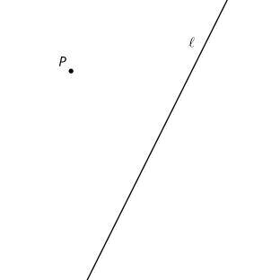
Find the Missing Endpoint
Line l is the perpendicular bisector of segment PS. Unfortunately, S got lost.
Use straightedge and compass moves to construct a line perpendicular to l that goes through P.
Mark point S. Explain or show your reasoning.
Unit 1 ● Lesson 6 ● Activity 4

Slide 28
angle bisector
A line through the vertex of an angle that divides it into two equal angles.
Unit 1 ● Lesson 6

Slide 29
circle
A circle of radius r with center O is the set of all points that are a distance r units from O.
To draw a circle of radius 3 and center O, use a compass to draw all the points at a distance 3 from O.
Unit 1 ● Lesson 6

Slide 30
conjecture
A reasonable guess that you are trying to either prove or disprove.
Unit 1 ● Lesson 6

Slide 31
inscribed
We say a polygon is inscribed in a circle if it fits inside the circle and every vertex of the polygon is on the circle. We say a circle is inscribed in a polygon if it fits inside the polygon and every side of the polygon is tangent to the circle.
Unit 1 ● Lesson 6

Slide 32
line segment
A set of points on a line with two endpoints.
Unit 1 ● Lesson 6

Slide 33
parallel
Two lines that don't intersect are called parallel. We can also call segments parallel if they extend into parallel lines.
Unit 1 ● Lesson 6

Slide 34
perpendicular bisector
The perpendicular bisector of a segment is a line through the midpoint of the segment that is perpendicular to it.
Unit 1 ● Lesson 6

Slide 35
Unit 1 ● Lesson 6
I can construct a parallel line through a given point.
I can construct a perpendicular line through a given point.

