Slide 1
Thursday, June 9th – 1B and 2B *OMHS will close 2 hours early due to graduation ceremony.
Friday, June 10th – 2A and 4A
Monday, June 13th – 3B and 4B
Tuesday, June 14th – 1A and 3A *Field day is tentatively scheduled for fourth period on this day. If the weather cooperates, all students will eat on C lunch (grab and go) and report outside for fourth period.

Slide 2
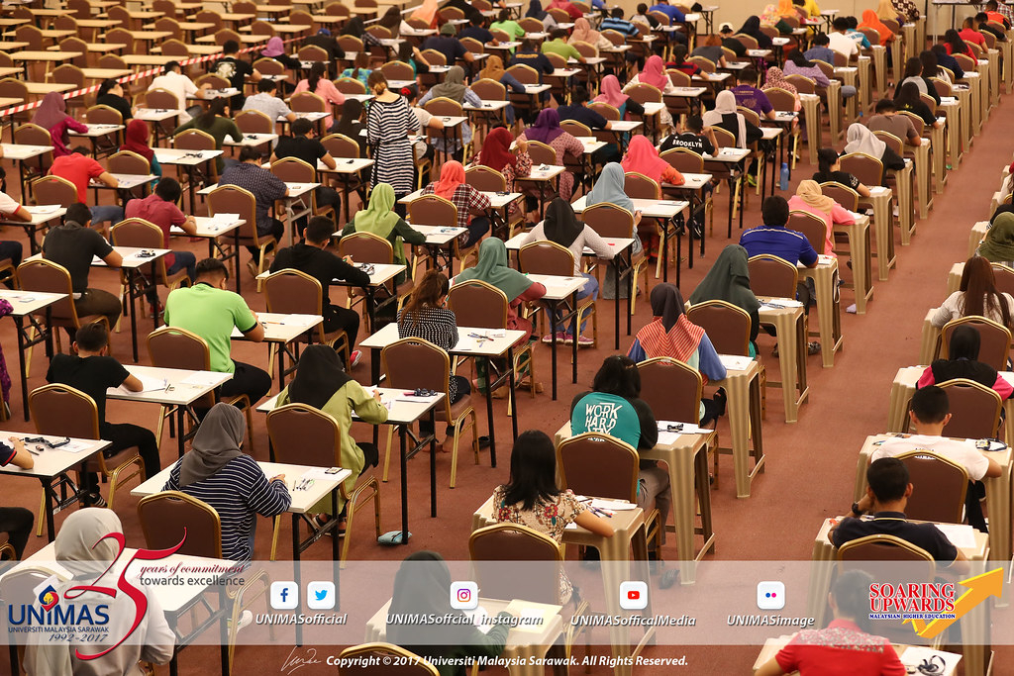
Parallel and Skew Lines
Vertical Angles
Linear Angles
Symmetry (Line/Rotational)
Dilations/Reflections/Translations
Converse, Inverse, Contrapositive
Triangle Congruence (SSS, SAS, ASA, AAS)
CPCTC
Similarity (Proportions)
Pythagorean Theorem
Types of Triangles (Acute, Obtuse, Right)
Right Triangle Trig (Sine, Cosine, Tangent)
a. Finding Missing Sides
b. Finding Missing Angles (Inverse Trig)
13. Area (Circles, Triangles)
14. Circumference and Perimeter
15. Volume and Surface Area (Cones, Cylinders, Prisms, Pyramids, Cones)
16. Parallel Lines and Transversals
17. Midpoint/Distance/Slope Formulas
18. Equations of Circles
19. Angles in/on/outside of Circles
20. Segments in/outside Circles

