Slide 1
F1b Angle Bisectors

Slide 2
Drill: Wed, 1/4
1. If the measure of BC is 4x +3 and the measure of AC is 5x – 8, find x and BC.
2. Describe the main differences between the segment bisector theorem and it’s converse.
OBJ: SWBAT prove and apply theorems about angle bisectors.

Slide 3
Geo Sketchpad
Angle Bisector
Notes:
Construct angle and bisector, plot point on bisector, highlight point and one ray, measure distance, …measure other distance, move the point

Slide 4
So… what conjecture can we make???

Slide 6
Based on these theorems, an angle bisector can be defined as the locus of all points in the interior of the angle that are equidistant from the sides of the angle.

Slide 7
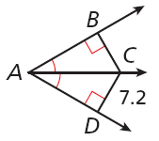
Applying the Angle Bisector Theorem
Find the measure.
BC

Slide 8
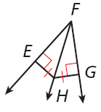
Example 2B: Applying the Angle Bisector Theorem
Find the measure.
m∠EFH, given that m∠EFG = 50°.
Def. of ∠ bisector
Substitute 50° for m∠EFG.

Slide 9
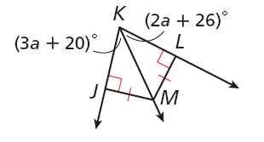
Example 2C: Applying the Angle Bisector Theorem
Find m∠MKL.
So m∠MKL = [2(6) + 26]° = 38°

Slide 10
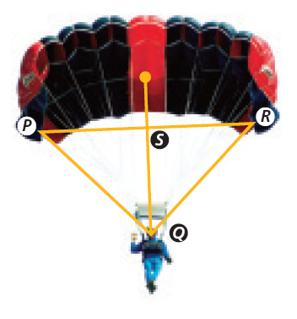
Check It Out! Example 3
S is equidistant from each pair of suspension lines. What can you conclude about QS?
QS bisects ∠ PQR.

Slide 11
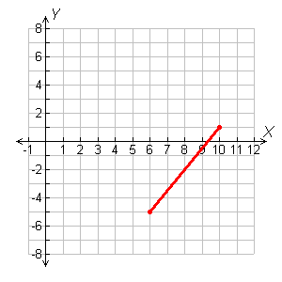
Example 4: Writing Equations of Bisectors in the Coordinate Plane
Write an equation in point-slope form for the perpendicular bisector of the segment with endpoints C(6, –5) and D(10, 1).
Step 1 Graph .
The perpendicular bisector of is perpendicular to at its midpoint.

Slide 12
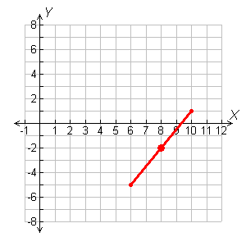
Example 4 Continued
Step 2 Find the midpoint of .
Midpoint formula.
mdpt. of =

Slide 13
Example 4 Continued
Step 3 Find the slope of the perpendicular bisector.
Slope formula.
Since the slopes of perpendicular lines are opposite reciprocals, the slope of the perpendicular bisector is

Slide 14
Example 4 Continued
Step 4 Use point-slope form to write an equation. The perpendicular bisector of has slope and passes through (8, –2).
y – y₁ = m(x – x₁)
Point-slope form
Substitute –2 for y₁, for m, and 8 for x₁.

Slide 15
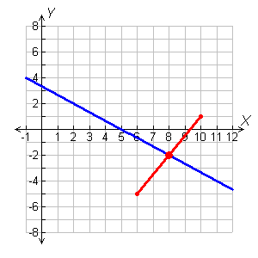
Example 4 Continued

Slide 16
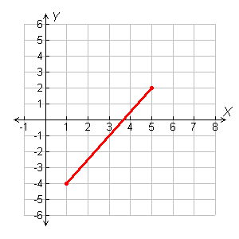
Check It Out! Example 4
Write an equation in point-slope form for the perpendicular bisector of the segment with endpoints P(5, 2) and Q(1, –4).
Step 1 Graph PQ.
The perpendicular bisector of is perpendicular to at its midpoint.

Slide 17
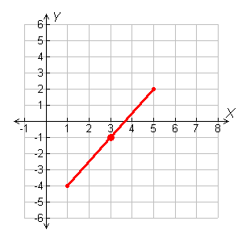
Check It Out! Example 4 Continued
Step 2 Find the midpoint of PQ.
Midpoint formula.

Slide 18
Check It Out! Example 4 Continued
Step 3 Find the slope of the perpendicular bisector.
Slope formula.
Since the slopes of perpendicular lines are
opposite reciprocals, the slope of the
perpendicular bisector is .

Slide 19
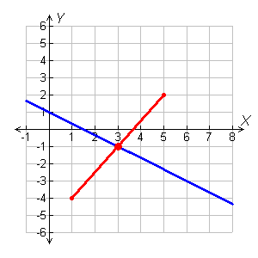
Check It Out! Example 4 Continued
Step 4 Use point-slope form to write an equation.
The perpendicular bisector of PQ has slope and passes through (3, –1).
y – y₁ = m(x – x₁)
Point-slope form
Substitute.

Slide 20
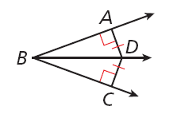
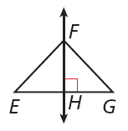
Lesson Quiz: Part I
Use the diagram for Items 1–2.
1. Given that m∠ABD = 16°, find m∠ABC.
2. Given that m∠ABD = (2x + 12)° and m∠CBD = (6x – 18)°, find m∠ABC.
32°
54°
Use the diagram for Items 3–4.
3. Given that FH is the perpendicular bisector of EG, EF = 4y – 3, and FG = 6y – 37, find FG.
4. Given that EF = 10.6, EH = 4.3, and FG = 10.6, find EG.
65
8.6

Slide 21
Lesson Quiz: Part II
5. Write an equation in point-slope form for the perpendicular bisector of the segment with endpoints X(7, 9) and Y(–3, 5) .

Slide 22
Example 3: Application
John wants to hang a spotlight along the back of a display case. Wires AD and CD are the same length, and A and C are equidistant from B. How do the wires keep the spotlight centered?
It is given that . So D is on the perpendicular bisector of by the Converse of the Angle Bisector Theorem. Since B is the midpoint of , is the perpendicular bisector of . Therefore the spotlight remains centered under the mounting.

