Slide 1
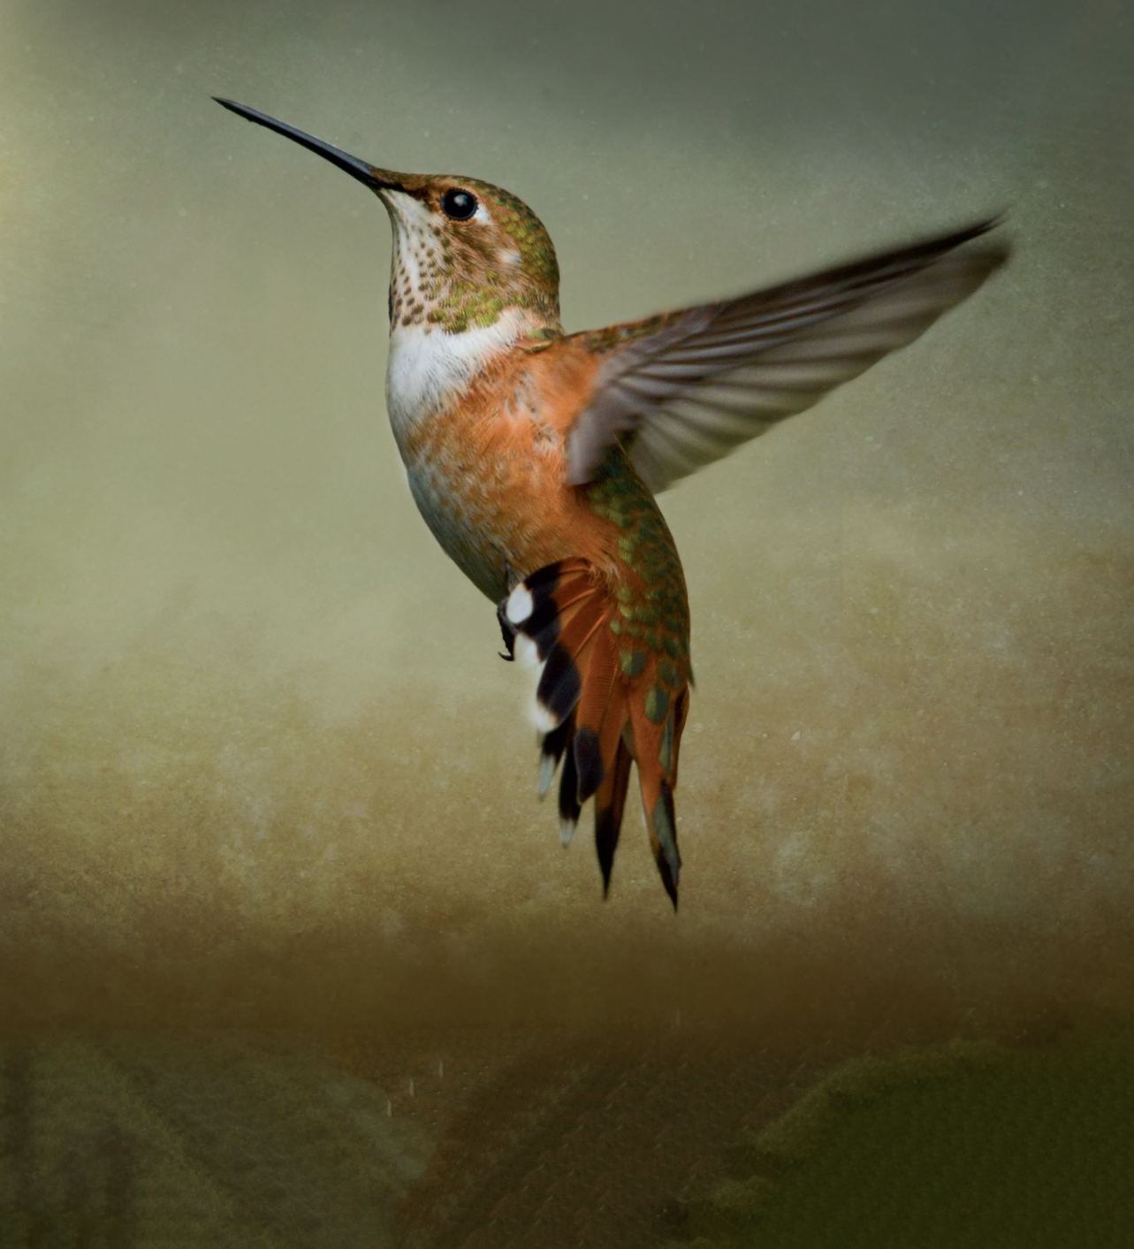
Chapter 2: The Derivative and Its Properties
Section 2.4 Differentiating the product and the quotient of two functions;
higher-order derivatives

Slide 2
2.4 Differentiating the Product and the Quotient of Two Functions; Higher-Order Derivatives
Objectives:
Differentiate the product of two functions
Differentiate the quotient of two functions
Find higher-order derivatives
Find the acceleration of an object in rectilinear motion

Slide 3
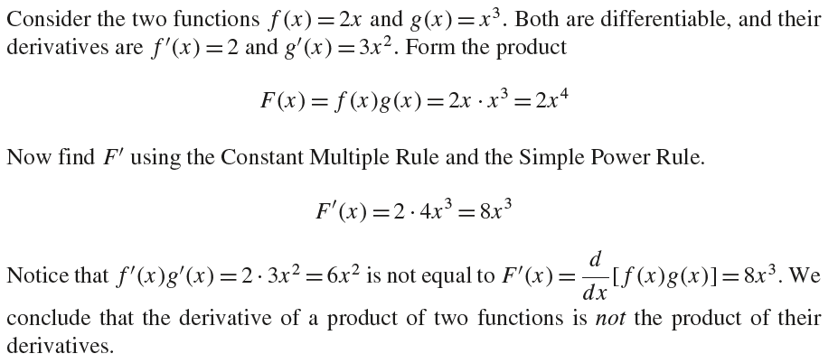
2.4 Differentiating the Produce and the Quotient of Two Functions; Higher-Order Derivatives

Slide 4
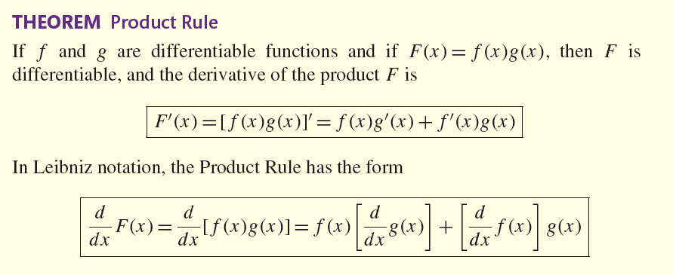
2.4 Differentiating the Produce and the Quotient of Two Functions; Higher-Order Derivatives

Slide 5
2.4 Differentiating the Produce and the Quotient of Two Functions; Higher-Order Derivatives

Slide 6
2.4 Differentiating the Produce and the Quotient of Two Functions; Higher-Order Derivatives

Slide 7
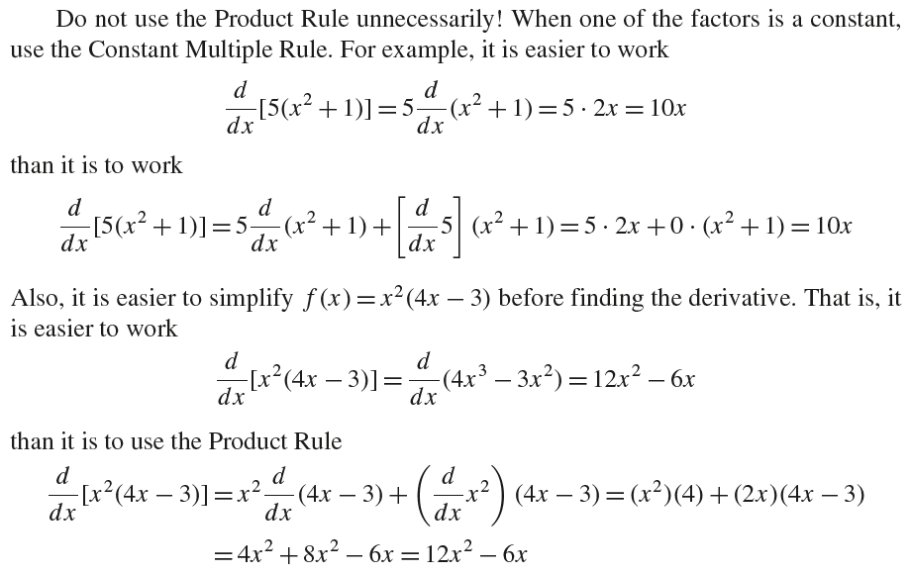
2.4 Differentiating the Produce and the Quotient of Two Functions; Higher-Order Derivatives

Slide 8
2.4 Differentiating the Produce and the Quotient of Two Functions; Higher-Order Derivatives

Slide 9
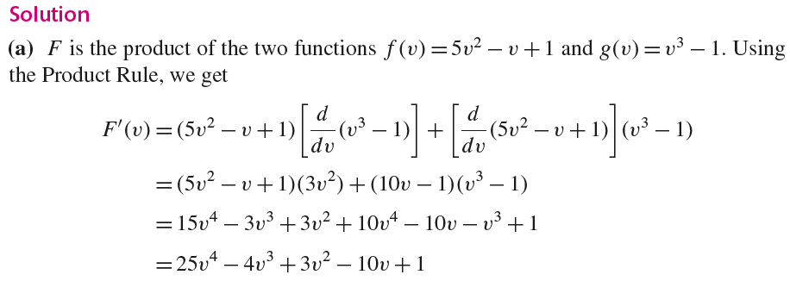
2.4 Differentiating the Produce and the Quotient of Two Functions; Higher-Order Derivatives

Slide 10
2.4 Differentiating the Produce and the Quotient of Two Functions; Higher-Order Derivatives

Slide 11
2.4 Differentiating the Produce and the Quotient of Two Functions; Higher-Order Derivatives

Slide 12
2.4 Differentiating the Produce and the Quotient of Two Functions; Higher-Order Derivatives

Slide 13
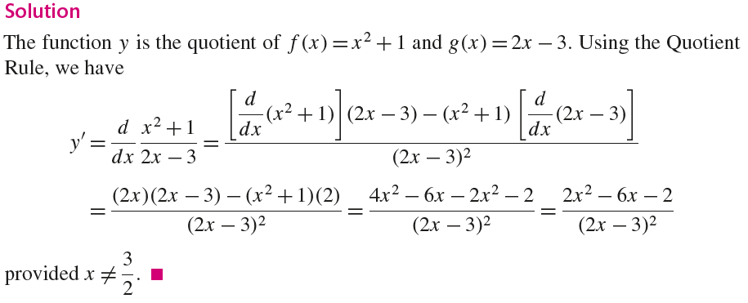
2.4 Differentiating the Produce and the Quotient of Two Functions; Higher-Order Derivatives

Slide 14
2.4 Differentiating the Produce and the Quotient of Two Functions; Higher-Order Derivatives

Slide 15
2.4 Differentiating the Produce and the Quotient of Two Functions; Higher-Order Derivatives

Slide 16
2.4 Differentiating the Produce and the Quotient of Two Functions; Higher-Order Derivatives

Slide 17
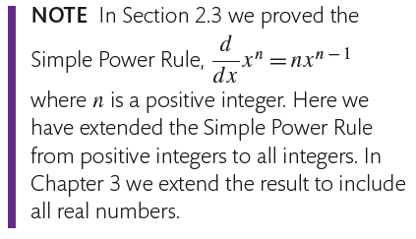
2.4 Differentiating the Produce and the Quotient of Two Functions; Higher-Order Derivatives

Slide 18
2.4 Differentiating the Produce and the Quotient of Two Functions; Higher-Order Derivatives
0

Slide 19
2.4 Differentiating the Produce and the Quotient of Two Functions; Higher-Order Derivatives

Slide 20
2.4 Differentiating the Produce and the Quotient of Two Functions; Higher-Order Derivatives

Slide 21
2.4 Differentiating the Produce and the Quotient of Two Functions; Higher-Order Derivatives

Slide 22
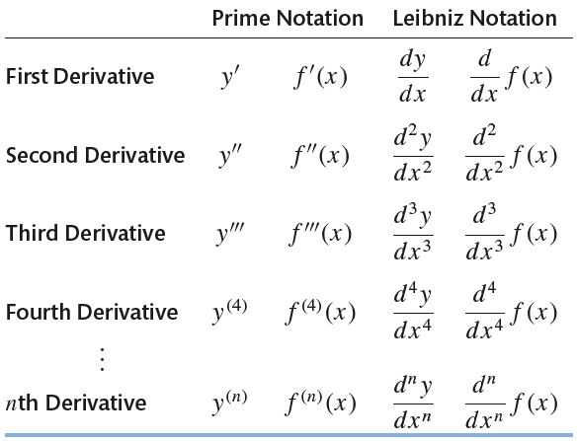
2.4 Differentiating the Produce and the Quotient of Two Functions; Higher-Order Derivatives

Slide 23
2.4 Differentiating the Produce and the Quotient of Two Functions; Higher-Order Derivatives

Slide 24
2.4 Differentiating the Produce and the Quotient of Two Functions; Higher-Order Derivatives

Slide 25
2.4 Differentiating the Produce and the Quotient of Two Functions; Higher-Order Derivatives

Slide 26
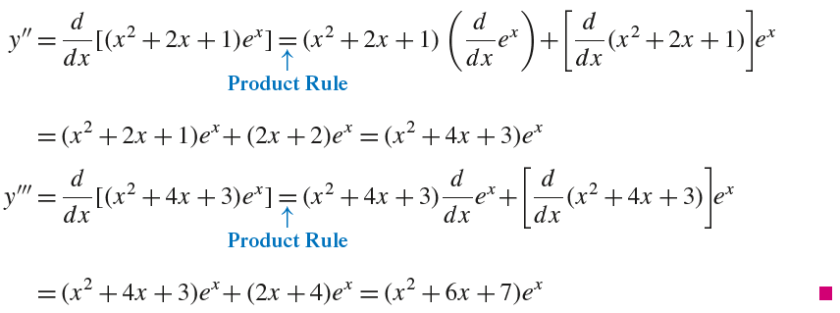
2.4 Differentiating the Produce and the Quotient of Two Functions; Higher-Order Derivatives

Slide 27
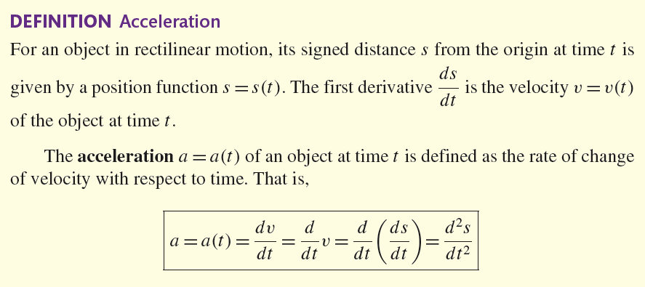
2.4 Differentiating the Produce and the Quotient of Two Functions; Higher-Order Derivatives

Slide 28
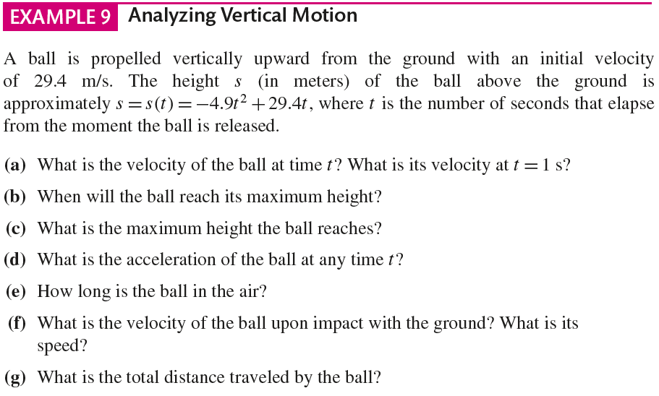
2.4 Differentiating the Produce and the Quotient of Two Functions; Higher-Order Derivatives

Slide 29
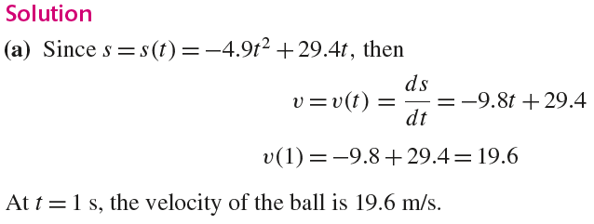
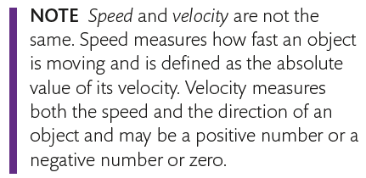
2.4 Differentiating the Produce and the Quotient of Two Functions; Higher-Order Derivatives

Slide 30
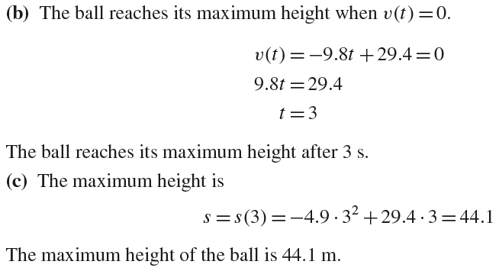
2.4 Differentiating the Produce and the Quotient of Two Functions; Higher-Order Derivatives

Slide 31
2.4 Differentiating the Produce and the Quotient of Two Functions; Higher-Order Derivatives

Slide 32
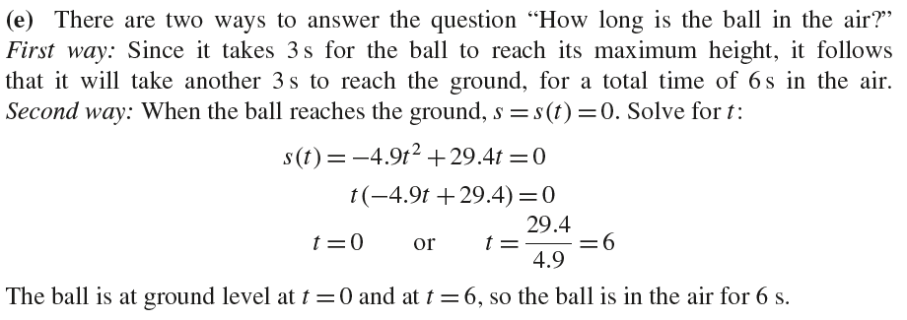
2.4 Differentiating the Produce and the Quotient of Two Functions; Higher-Order Derivatives

Slide 33
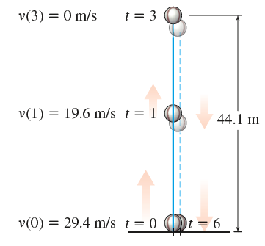
2.4 Differentiating the Produce and the Quotient of Two Functions; Higher-Order Derivatives

Slide 34
2.4 Differentiating the Produce and the Quotient of Two Functions; Higher-Order Derivatives

