Slide 1
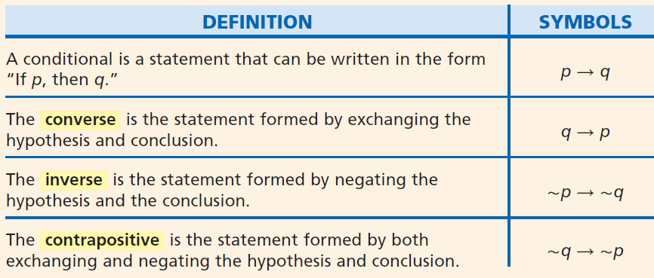
Drill: Mon, 10/27
1. Write a conditional statement for the statement “All Ravens fans are from Maryland”
2. Write the converse of your statement.
3. Write the contrapositive of the conditional.
Get out your Practice A homework!
OBJ: SWBAT write and analyze biconditional statements.

Slide 2
Unit C (2.4) Biconditional Statements
Honors Geometry
Notes:
Copy: C2b CN, C2b Practice A for HW

Slide 3
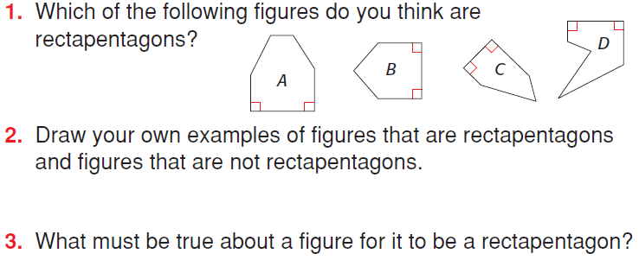

Slide 4
Examples (Write the Converse, Inverse and Contrapositive for Each)
If it snows six feet, then schools will be closed.
Converse: If schools will be closed, then it snowed six feet.
Inverse: If it does not snow six feet, then schools will not be closed.
Contrapositive: If schools will not be closed, then it did not snow six feet.
If it is December 25th, then it is Christmas Day.
Converse: If it is Christmas Day, then it is December 25th.
Inverse: If it is not December 25th, then it is not Christmas Day.
Contrapositive: If it not Christmas Day, then it is not December 25th.
Notes:
Discuss the difference btw the converse of both statements

Slide 5
When you combine a conditional statement and its converse, you create a biconditional statement.
A biconditional statement is a statement that can be written in the form “p if and only if q.” This means “if p, then q” and “if q, then p.”

Slide 6
p q means p q and q p
Writing Math
The biconditional “p if and only if q” can also be written as “p iff q” or p ↔ q.

Slide 7
Example 1A: Identifying the Conditionals within a Biconditional Statement
Write the conditional statement and converse within the biconditional.
An angle is obtuse if and only if its measure is greater than 90° and less than 180°.
Conditional: If an ∠ is obtuse, then its measure is greater than 90° and less than 180°.
Converse: If an angle's measure is greater than 90° and less than 180°, then it is obtuse.

Slide 8
Example 1B: Identifying the Conditionals within a Biconditional Statement
Write the conditional statement and converse within the biconditional.
A solution is neutral ↔ its pH is 7.
Conditional: If a solution is neutral, then its pH is 7.
Converse: If a solution’s pH is 7, then it is neutral.

Slide 9
Check It Out! Example 1a
Write the conditional statement and converse within the biconditional.
An angle is acute iff its measure is greater than 0° and less than 90°.
Conditional: If an angle is acute, then its measure is greater than 0° and less than 90°.
Converse: If an angle’s measure is greater than 0° and less than 90°, then the angle is acute.

Slide 10
Check It Out! Example 1b
Write the conditional statement and converse within the biconditional.
Cho is a member if and only if he has paid the $5 dues.
Conditional: If Cho is a member, then he has paid the $5 dues.
Converse: If Cho has paid the $5 dues, then he is a member.

Slide 11
Example 2: Identifying the Conditionals within a Biconditional Statement
For each conditional, write the converse and a biconditional statement.
A. If 5x – 8 = 37, then x = 9.
Converse: If x = 9, then 5x – 8 = 37.
Biconditional: 5x – 8 = 37 if and only if x = 9.
B. If two angles have the same measure, then they are congruent.
Converse: If two angles are congruent, then they have the same measure.
Biconditional: Two angles have the same measure if and only if they are congruent.

Slide 12
Check It Out! Example 2a
For the conditional, write the converse and a biconditional statement.
If the date is July 4th, then it is Independence Day.
Converse: If it is Independence Day, then the date is July 4th.
Biconditional: It is July 4th if and only if it is Independence Day.

Slide 13
Check It Out! Example 2b
For the conditional, write the converse and a biconditional statement.
If points lie on the same line, then they are collinear.
Converse: If points are collinear, then they lie on the same line.
Biconditional: Points lie on the same line if and only if they are collinear.

Slide 14
For a biconditional statement to be true, both the conditional statement and its converse must be true. If either the conditional or the converse is false, then the biconditional statement is false.
Notes:
Skip?

Slide 15
Example 3A: Analyzing the Truth Value of a Biconditional Statement
Determine if the biconditional is true. If false, give a counterexample.
A rectangle has side lengths of 12 cm and 25 cm if and only if its area is 300 cm².

Slide 16
Example 3A: Analyzing the Truth Value of a Biconditional Statement
Conditional: If a rectangle has side lengths of 12 cm and 25 cm, then its area is 300 cm².
The conditional is true.
Converse: If a rectangle’s area is 300 cm², then it has side lengths of 12 cm and 25 cm.
The converse is false.
If a rectangle’s area is 300 cm², it could have side lengths of 10 cm and 30 cm. Because the converse is false, the biconditional is false.
Notes:
Skip?

Slide 17
Example 3B: Analyzing the Truth Value of a Biconditional Statement
Determine if the biconditional is true. If false, give a counterexample.
A natural number n is odd ↔ n² is odd.
Conditional: If a natural number n is odd, then n² is odd.
The conditional is true.
Converse: If the square n² of a natural number is odd, then n is odd.
The converse is true.
Since the conditional and its converse are true, the biconditional is true.
Notes:
Skip?

Slide 18
Check It Out! Example 3a
Determine if the biconditional is true. If false, give a counterexample.
An angle is a right angle iff its measure is 90°.
Conditional: If an angle is a right angle, then its measure is 90°.
The conditional is true.
Converse: If the measure of an angle is 90°, then it is a right angle.
The converse is true.
Since the conditional and its converse are true, the biconditional is true.
Notes:
Skip?

Slide 19
Check It Out! Example 3b
Determine if the biconditional is true. If false, give a counterexample.
y = –5 ↔ y² = 25
Conditional: If y = –5, then y² = 25.
The conditional is true.
Converse: If y² = 25, then
y = –5.
The converse is false.
The converse is false when y = 5. Thus, the biconditional is false.
Notes:
Skip?

Slide 20
In geometry, biconditional statements are used to write definitions.
A definition is a statement that describes a mathematical object and can be written as a true biconditional.

Slide 21
In the glossary, a polygon is defined as a closed plane figure formed by three or more line segments.

Slide 22
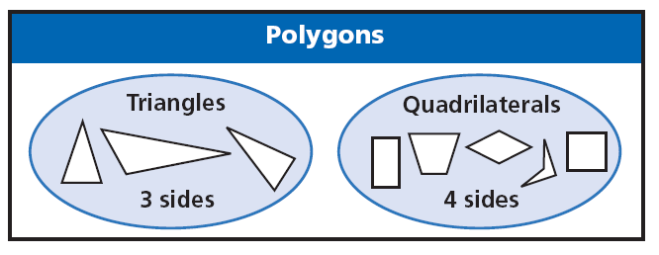
A triangle is defined as a three-sided polygon, and a quadrilateral is a four-sided polygon.

Slide 23
A Good Definition?
A square is a parallelogram.
A square is a parallelogram with four right angles.
Definitions must be reversible in order to be correct.
Notes:
Is this acceptable? Why not? …How is the second defn different?

Slide 24
Helpful Hint
Think of definitions as being reversible. Postulates, however are not necessarily true when reversed.

Slide 25
Example 4: Writing Definitions as Biconditional Statements
Write each definition as a biconditional.
A. A pentagon is a five-sided polygon.
B. A right angle measures 90°.
A figure is a pentagon if and only if it is a 5-sided polygon.
An angle is a right angle if and only if it measures 90°.

Slide 26
Check It Out! Example 4
Write each definition as a biconditional.
4a. A quadrilateral is a four-sided polygon.
4b. The measure of a straight angle is 180°.
A figure is a quadrilateral if and only if it is a 4-sided polygon.
An ∠ is a straight ∠ if and only if its measure is 180°.

Slide 27
Practice with Biconditionals
pp. 6 – 7, 20 – 21, 28, and 50
Work in pairs to rewrite the definitions as biconditional statements.

Slide 28
Practice A

Slide 29
Lesson Quiz
1. For the conditional “If an angle is right, then its measure is 90°,” write the converse and a biconditional statement.
2. Determine if the biconditional “Two angles are complementary if and only if they are both acute” is true. If false, give a counterexample.
Converse: If an ∠ measures 90°, then the ∠ is right.
Biconditional: An ∠ is right iff its measure is 90°.
False; possible answer: 30° and 40°
3. Write the definition “An acute triangle is a triangle with three acute angles” as a biconditional.
A triangle is acute iff it has 3 acute ∠s.

