Slide 1
Drill: Thursday, 9/15
Grab a calculator…
Evaluate. Round to the nearest hundredth.
1. 12²
2. 7.6²
3.
4.
5. 3²(π)
6. (3π)²
144
57.76
8
7.35
28.27
88.83
OBJ: SWBAT apply formulas for perimeter, area, and circumference in order to solve problems and analyze geometric relationships.

Slide 2
A5 Honors Geometry Using Formulas in Geometry
Notes:
Cope: A5 graphic org, A5 CN, A5 ET, dot paper

Slide 3
Environmental Challenge
Each year, approximately nine billion 20-ounce soda bottles are produced in the U.S.
* If all the bottles produced were lined end to end, approximately how many times would they go around the earth? Use 3980 miles as the radius of the earth and 1 mile = 5,280 feet.

Slide 4
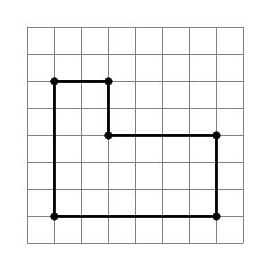
Notes:
Recall dfns for perimeter and area

Slide 5
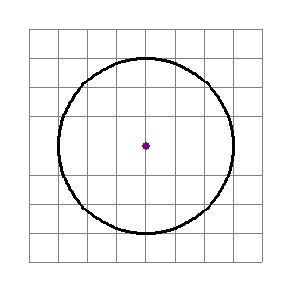
Notes:
How far around? How much room inside?

Slide 6
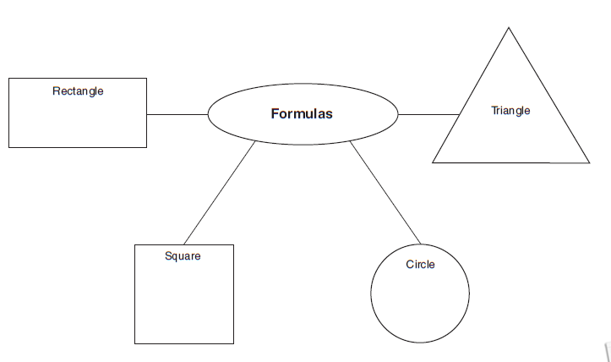
Notes:
Independent brainstorm for 2 mins, then complete as a class

Slide 7
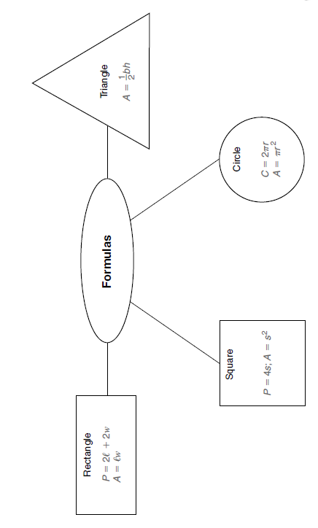

Slide 8
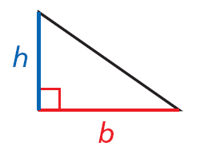
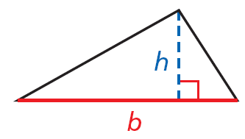
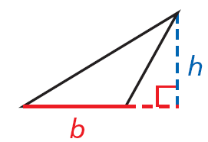
The base b can be any side of a triangle. The height h is a segment from a vertex that forms a right angle with a line containing the base. The height may be a side of the triangle or in the interior or the exterior of the triangle.

Slide 9
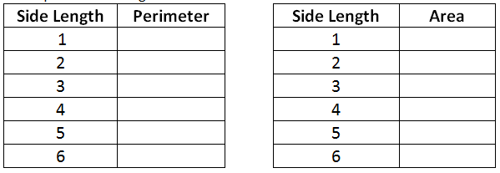

Slide 10
Virtual GeoBoard
Click Here
Safari Montage Video
(Area of Circles and Composite Figures)

Slide 11
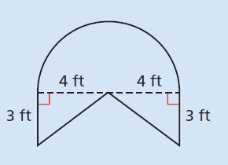
Real-World Problem
Our balcony needs a new railing, what is the perimeter of the figure (minus the doorways)?
The railing costs $20 per foot, what is the price?
Door
Door
Notes:
Don’t include the area with doors; part shown is a semi-circle

Slide 12
Real-World Problem
We want to create a “green roof” and need to lay down some sod. How many square feet do we need?
Door
Door

Slide 13
Exit Ticket
OBJ: SWBAT apply formulas for perimeter, area, and circumference in order to solve problems and analyze geometric relationships.
Notes:
How do you feel about applying formulas to solve these problems? What did you learn about the relationship between square side length and perimeter? …area?

